Slide 1
Meetup Trends
Liam Hood, Sean Horner, Kyle Pacheco, Edward Reed, Michael Splaver, Quan Vu

Slide 2
Meetup Introduction
Online service used to organize groups that host in-person and virtual events
Funded by fees paid to Meetup by organizers
Organizers can be anyone on the platform
Fees are per group that the organizer manages
Each group makes its own rules and puts itself into at least one of Meetups categories
There are 36 Category IDs with some IDs referring to the same Category
Acquired by WeWork in November, 2017 and then sold to AlleyCorp in March 2020

Slide 3
Data Gathering
Started with a list of cities
Searched for largest groups in that city associated with Tech
Category 34
Searched for all the events held by those groups
Limits had to be placed on how far forward we were willing to look as some groups had upcoming events many years in the future
Limited to events before 2022
Data was gathered over a 40 hour period and yielded approximately 15gb of data before data clean up.
The fields we used for analysis were saved to a parquet file

Slide 4
Analysis of Trends

Slide 5
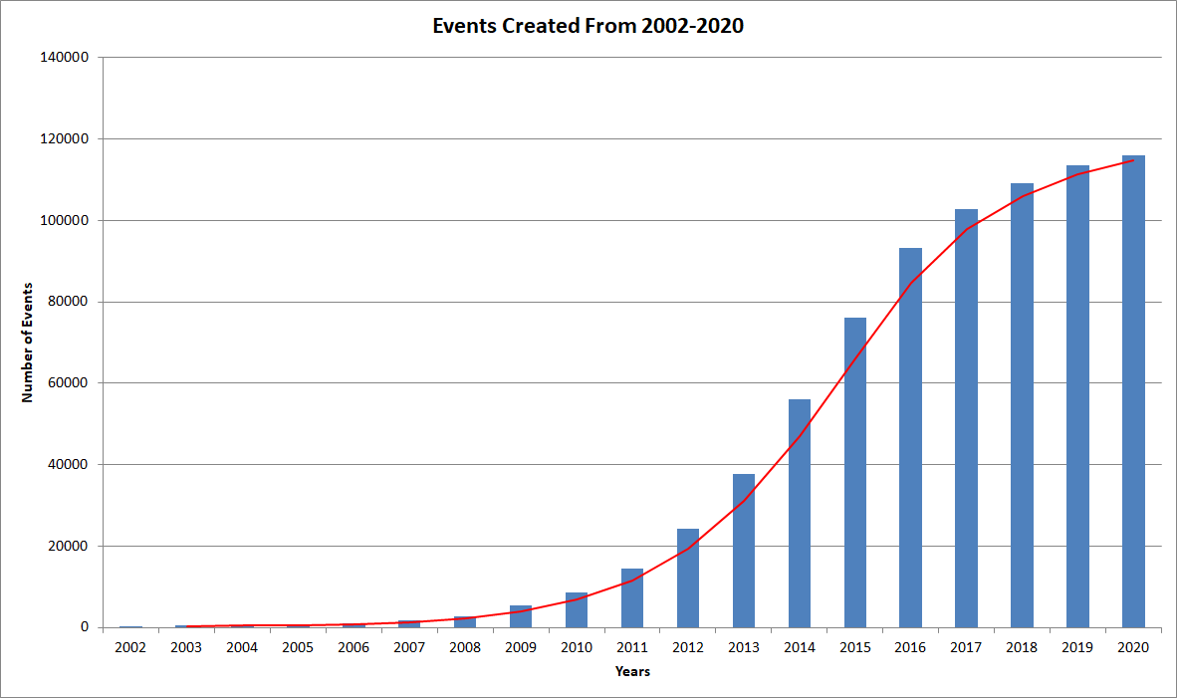
How many events were created for each month/year?

Slide 6
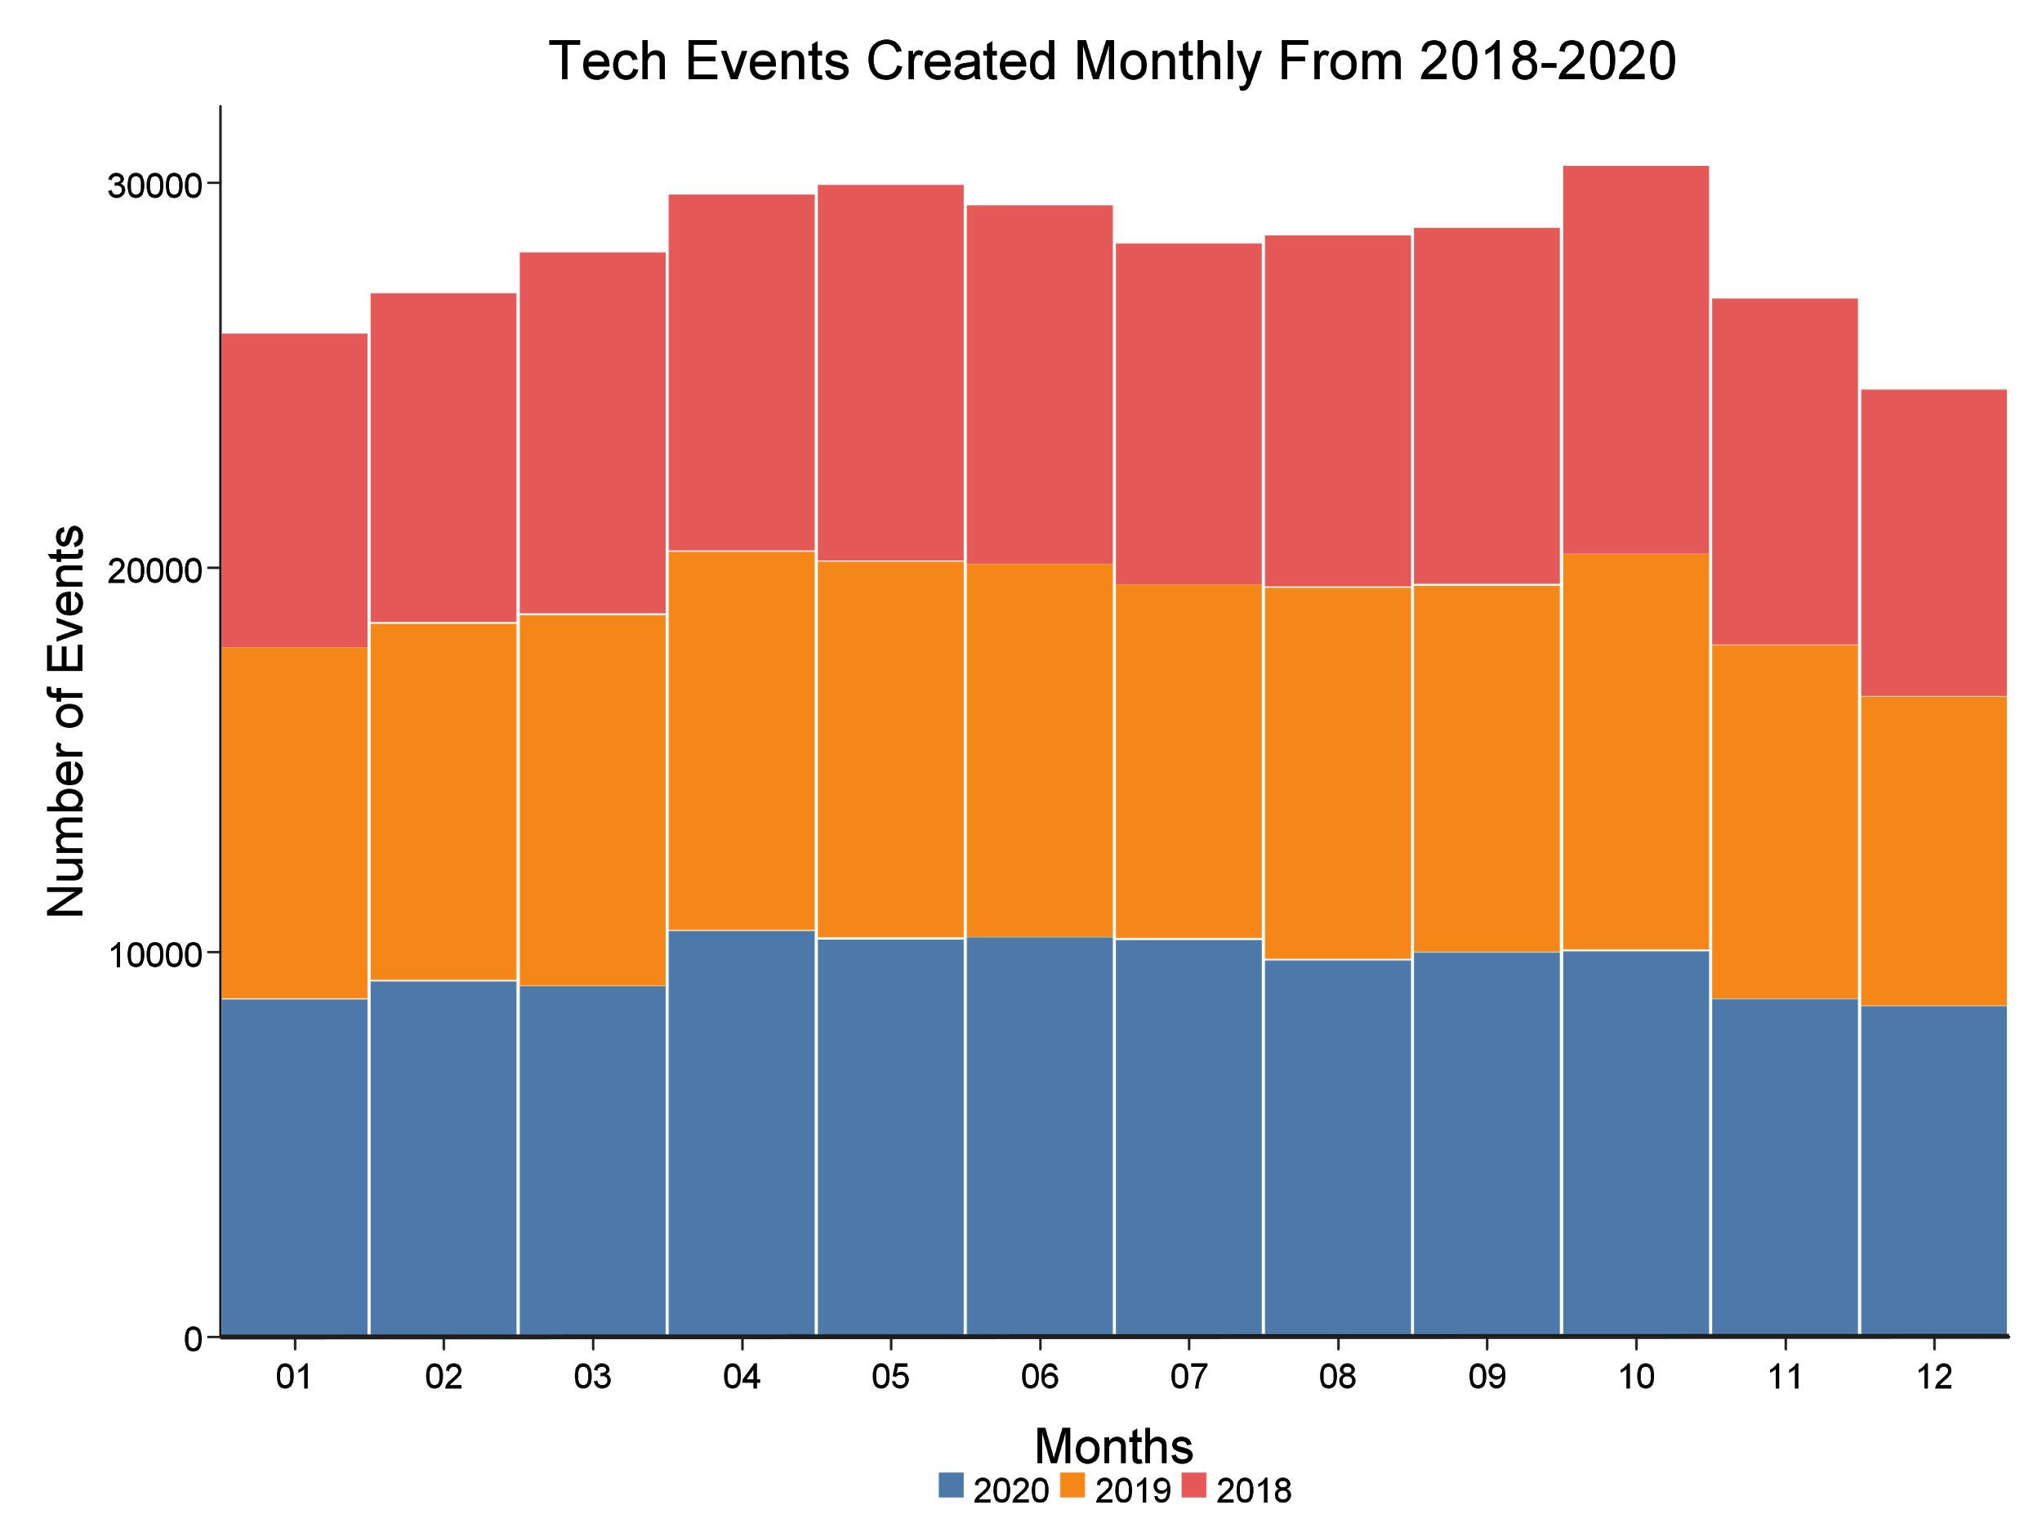

Slide 7
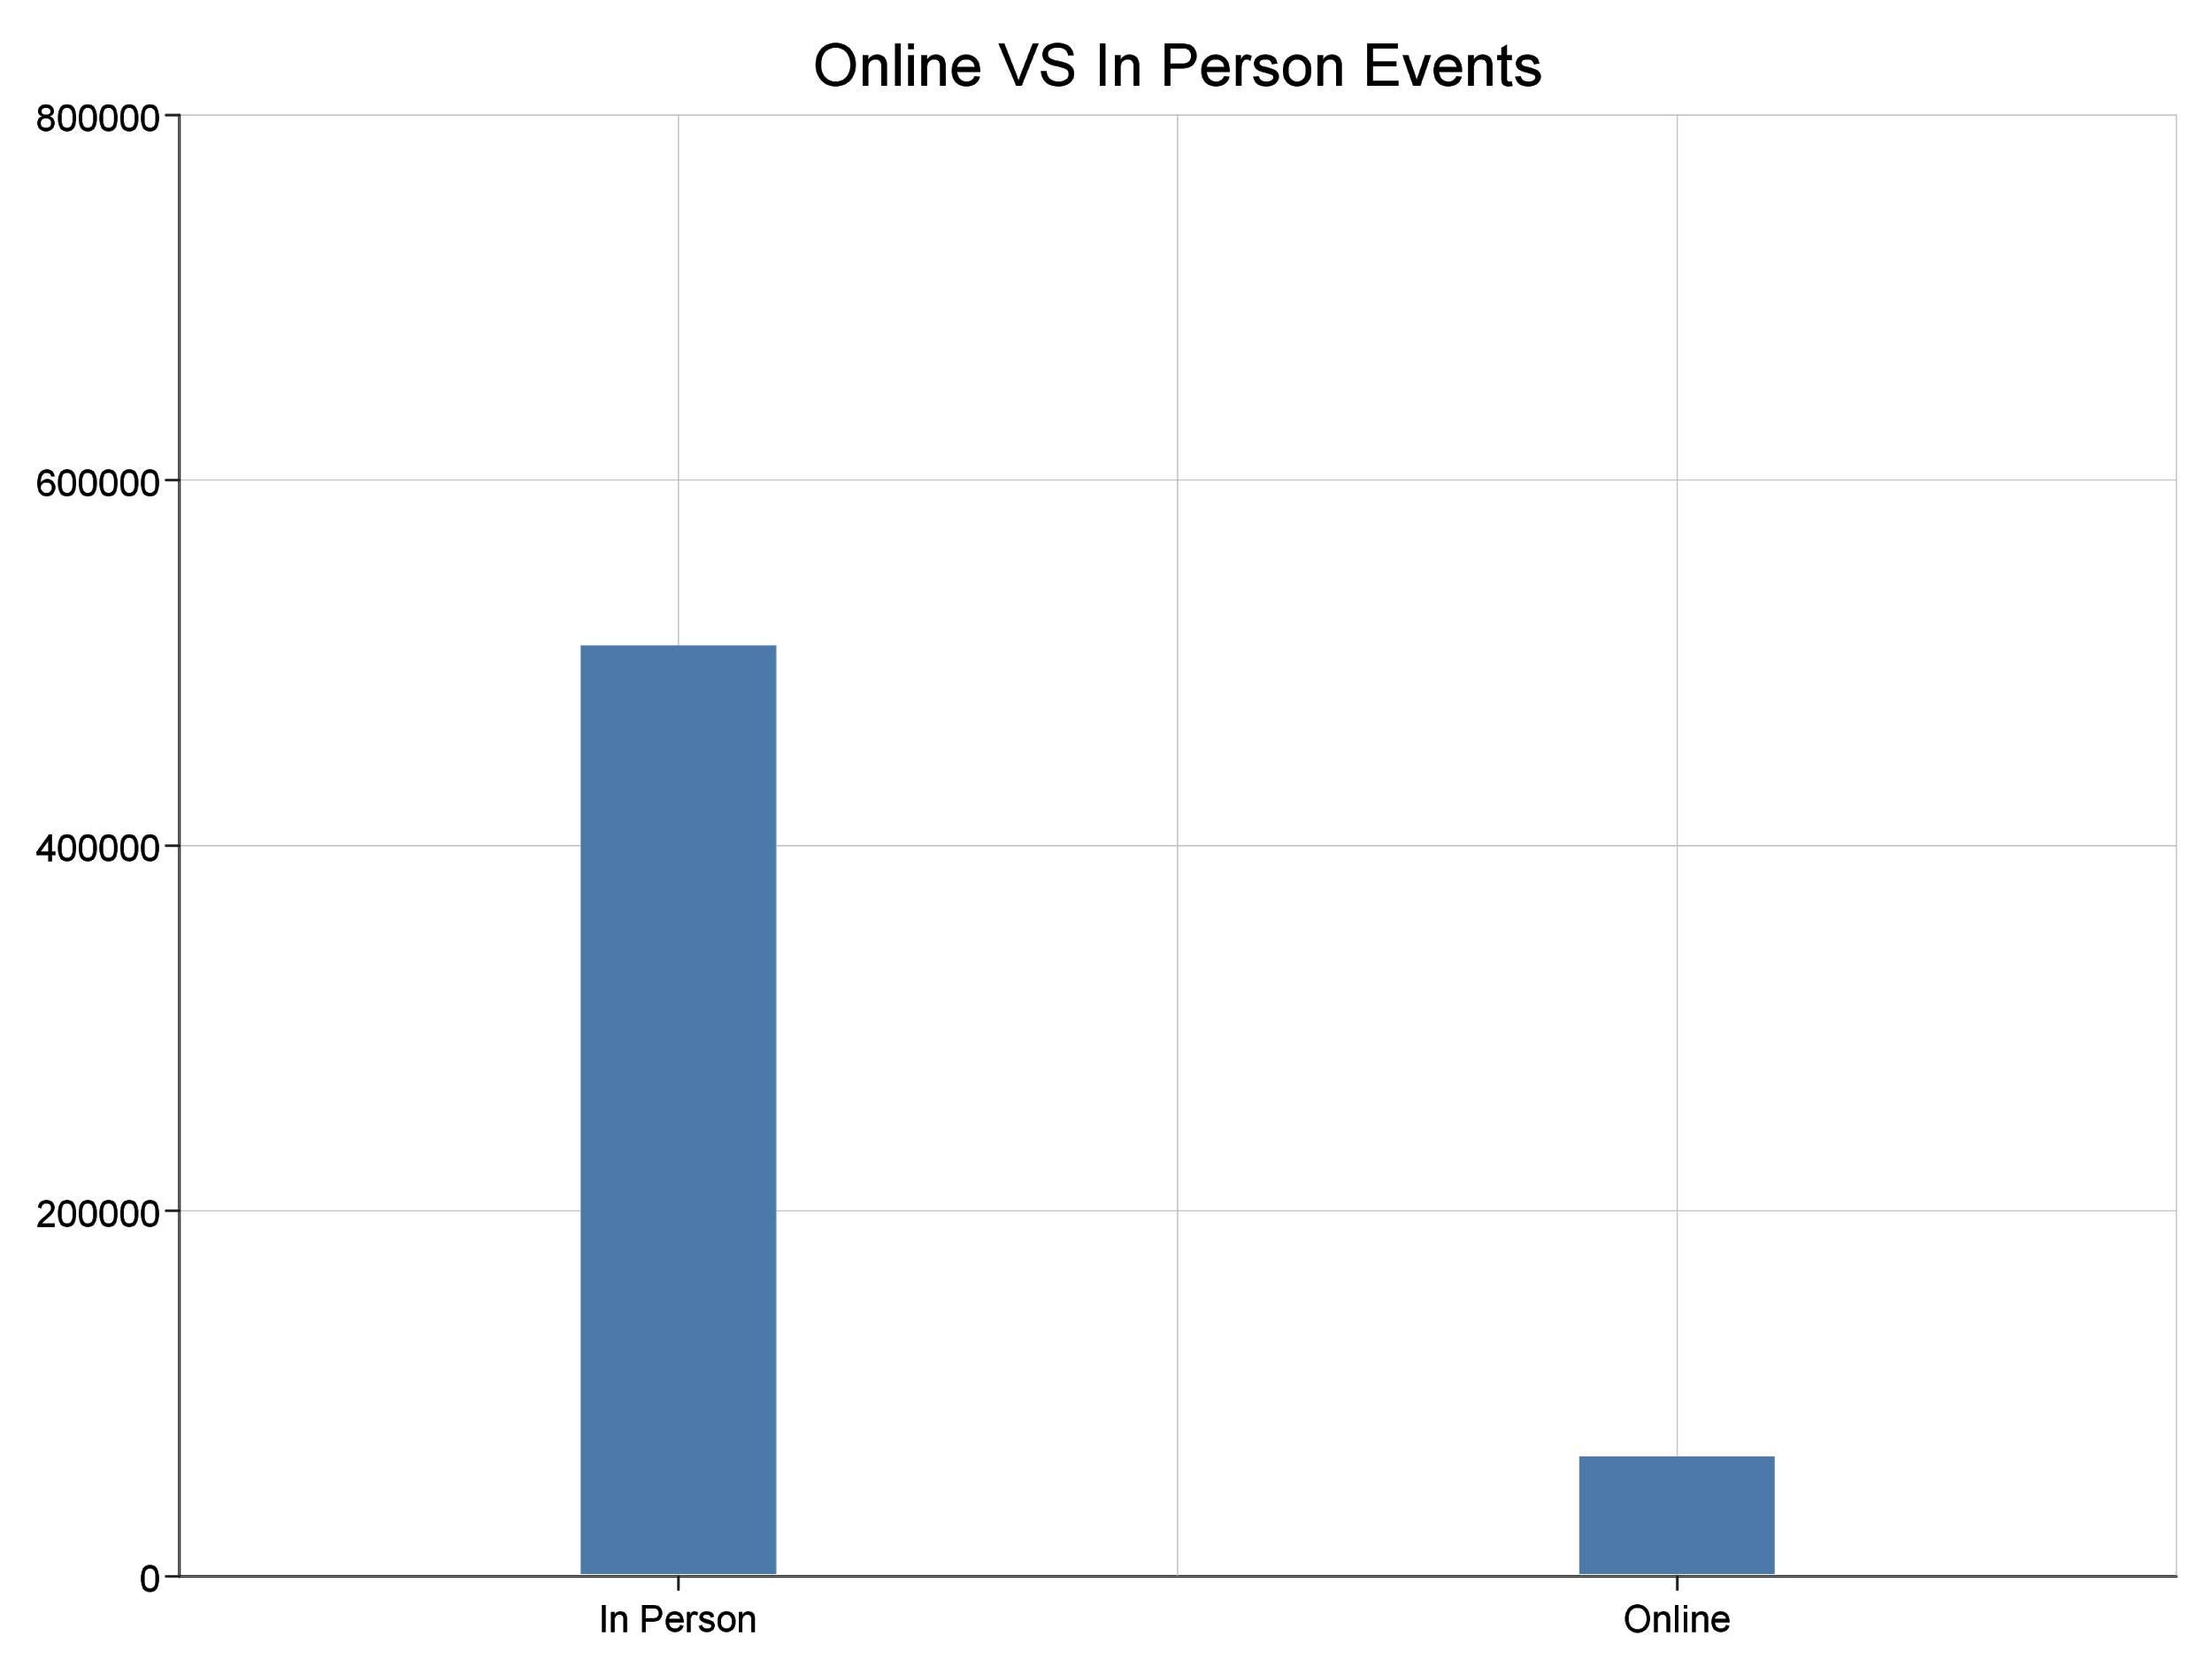
How many upcoming events are online compared to in person ones?
Total in person events: 509552
Total online events: 65474

Slide 8
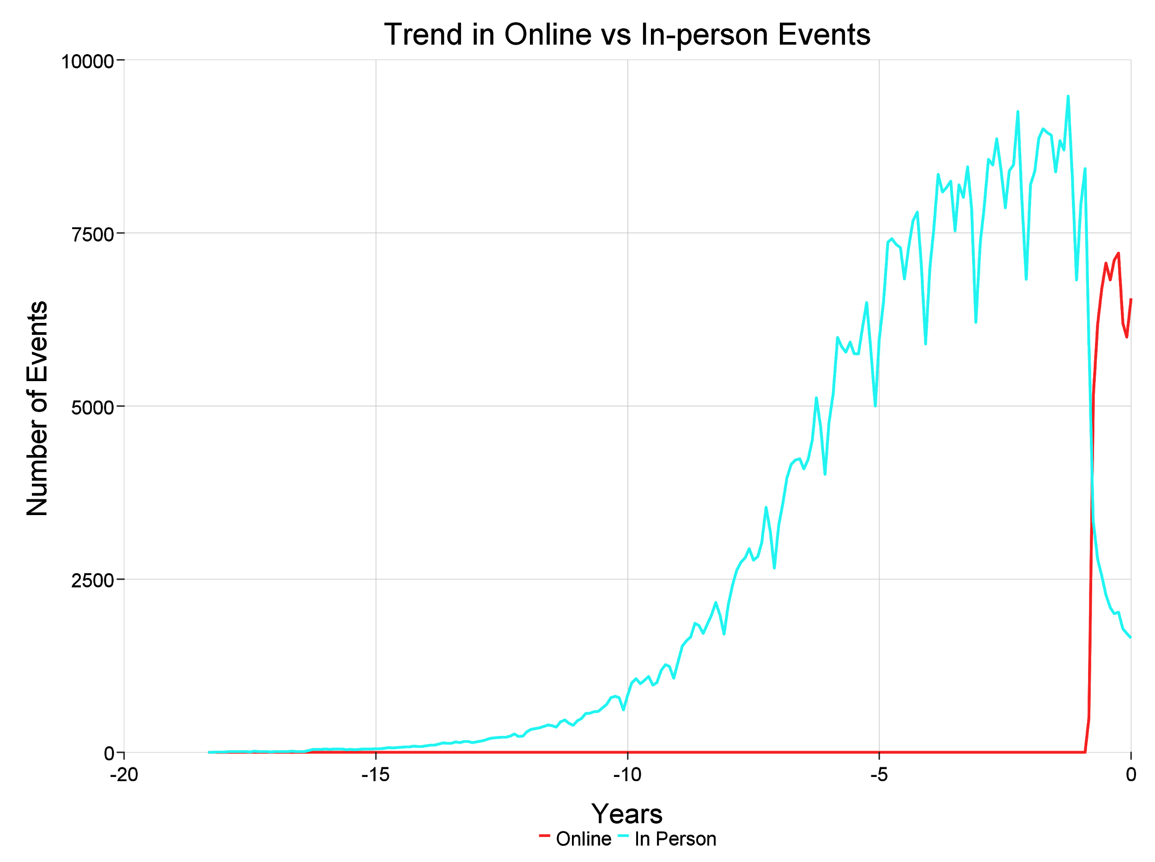
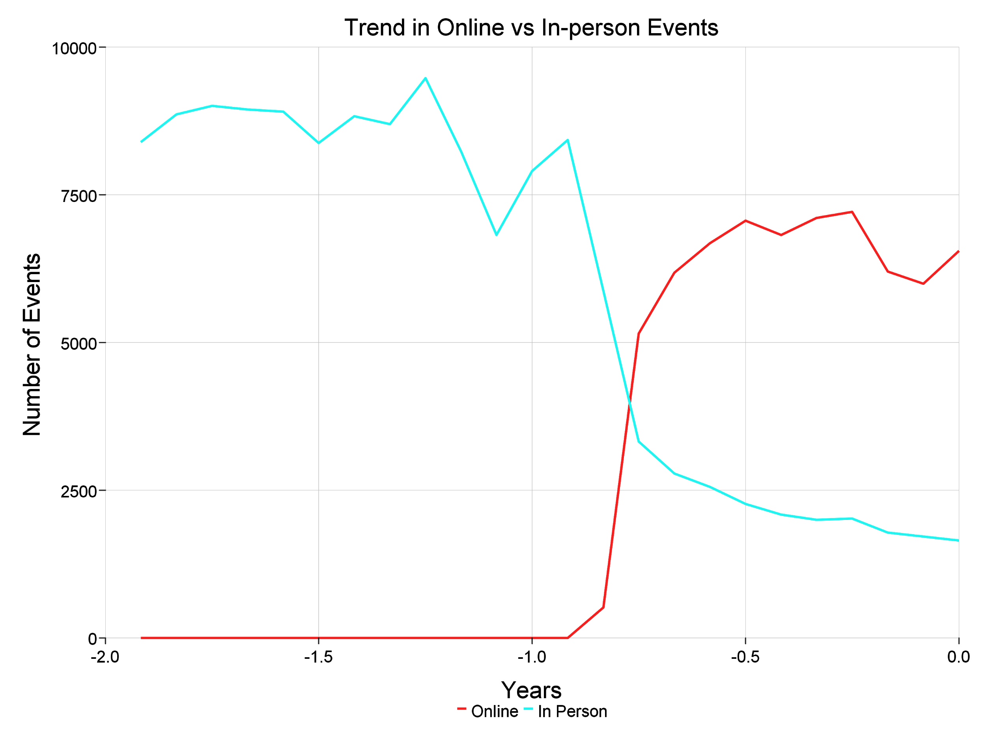
How has the number of in person vs online events changed over time?
The number of online events rapidly increased after March of 2020
Introduced in February
In person events have a dramatic fall to about a quarter of their previous total
Total number events stayed fairly consistent through this change
Notes:
Slight dip in total in march

Slide 9
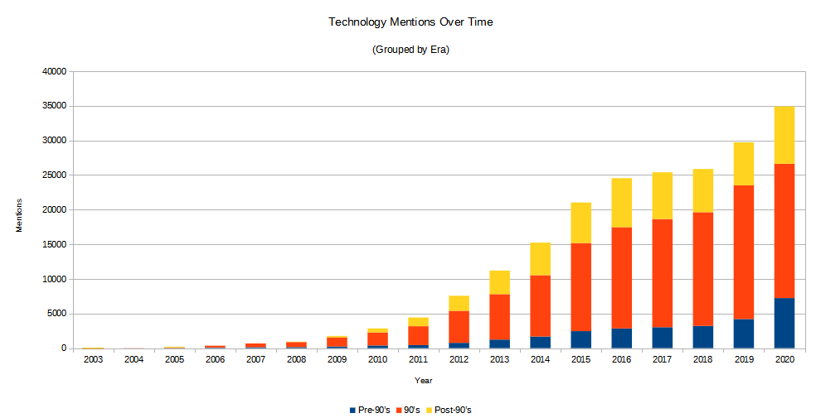
What is the trend of new tech vs. established tech meetups?

Slide 10
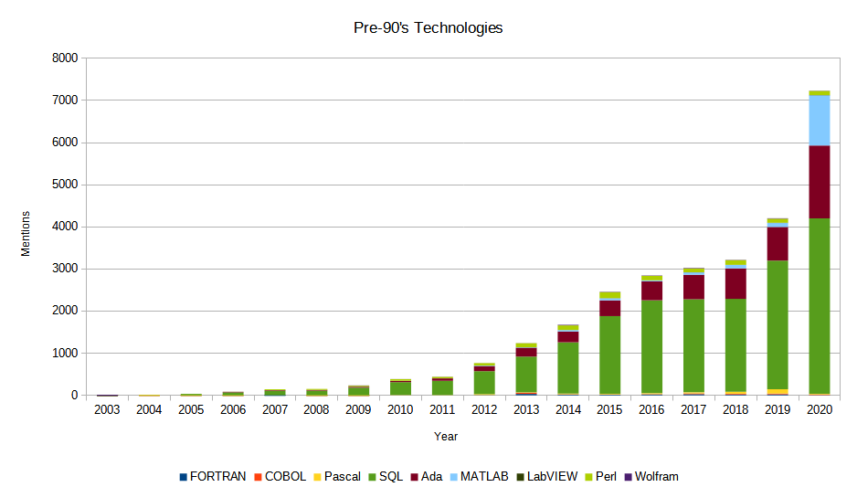
What is the trend of new tech vs established tech meetups?

Slide 11
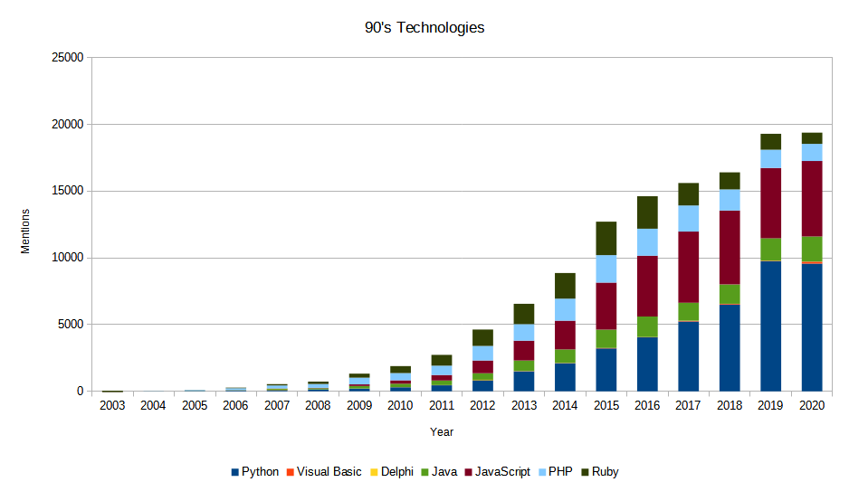
What is the trend of new tech vs established tech meetups?

Slide 12
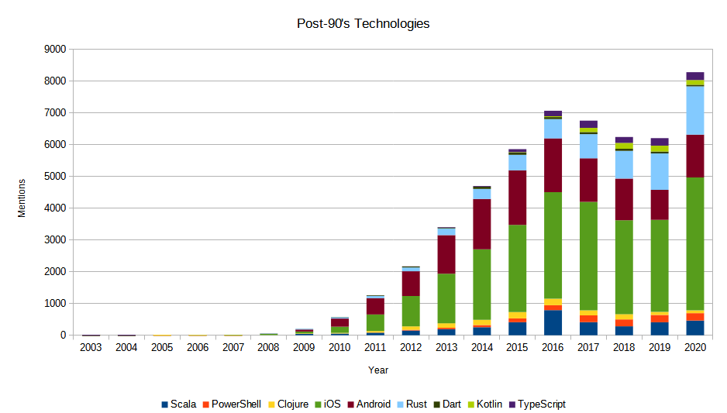
What is the trend of new tech vs established tech meetups?

Slide 13
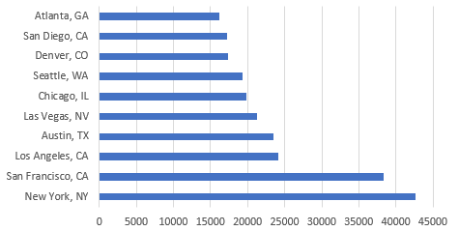
Which cities hosted the most tech based events?

Slide 14
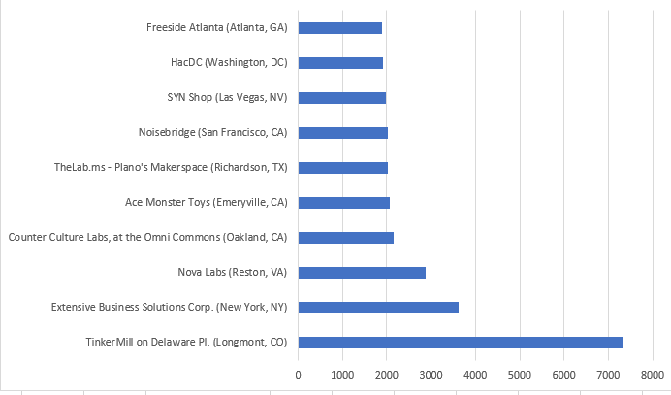
Which venues have hosted the most events?

Slide 15
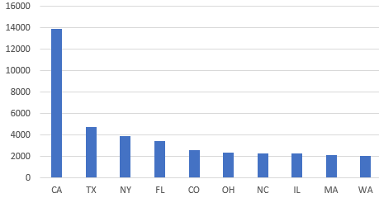
Which states have the most venues?
California has the most venues with around 14000.
The next closest is Texas with around 4500.

Slide 16
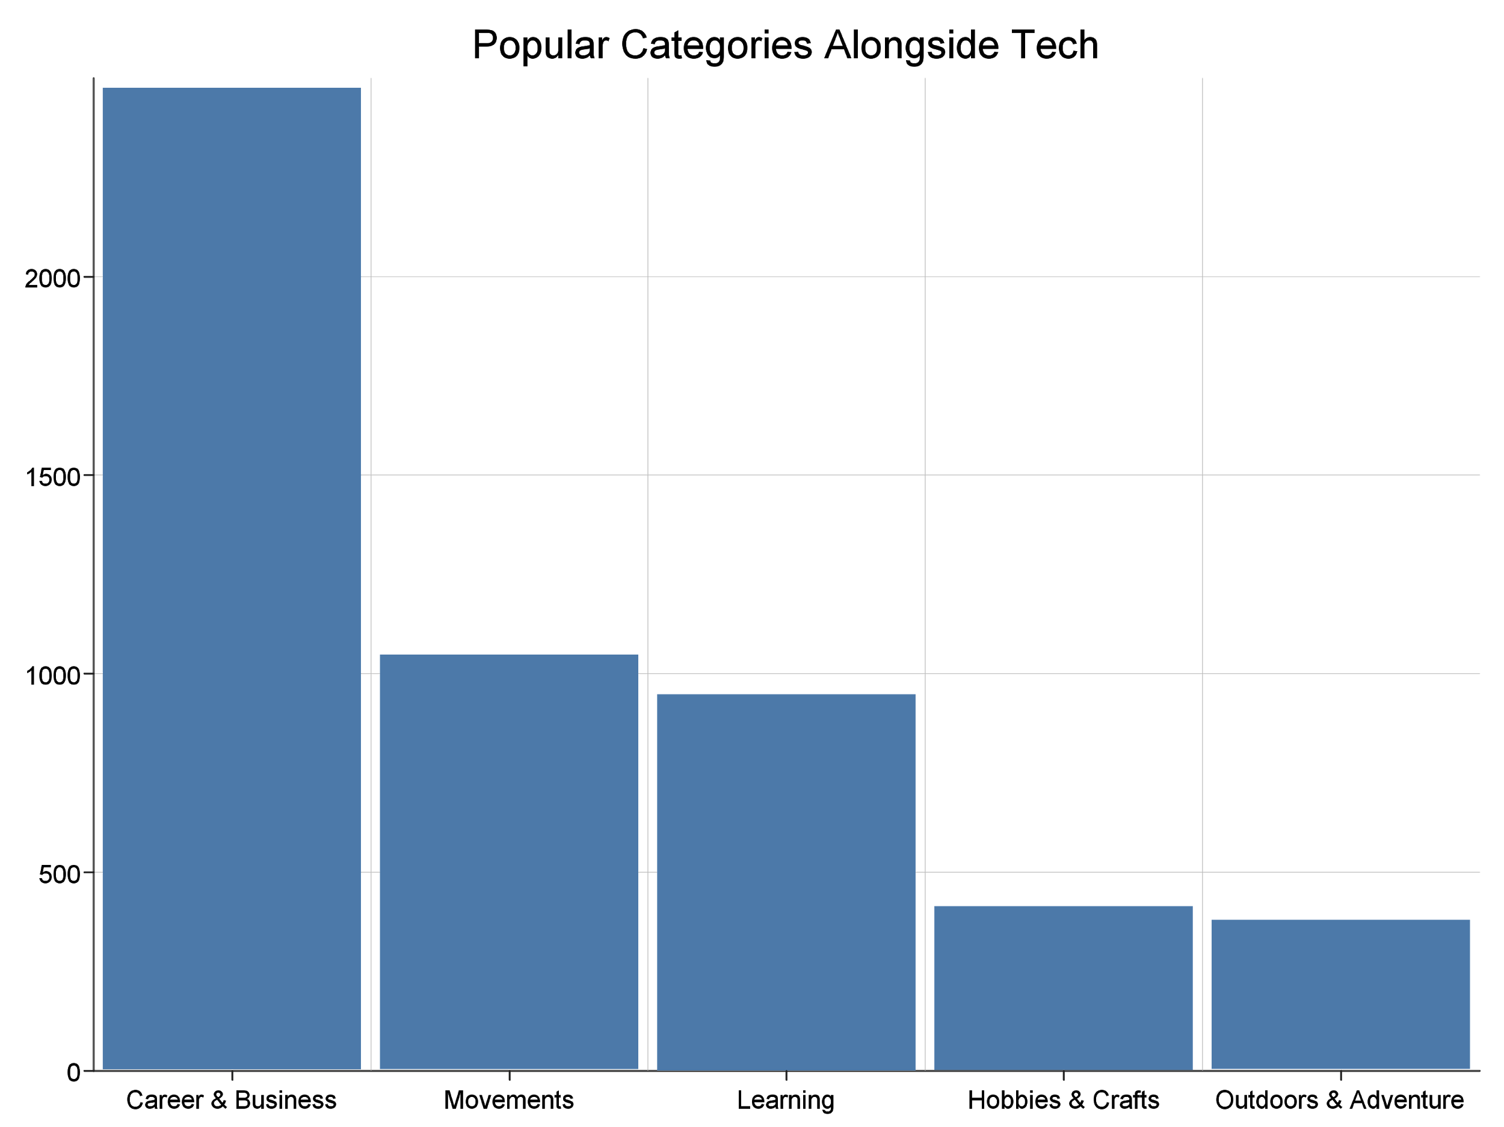
What are some of the most common meetup topics?
Career and Business is the most commonly used category alongside of the tech category
Even the most common additional topic is still only attached to less than one percent of events

Slide 17
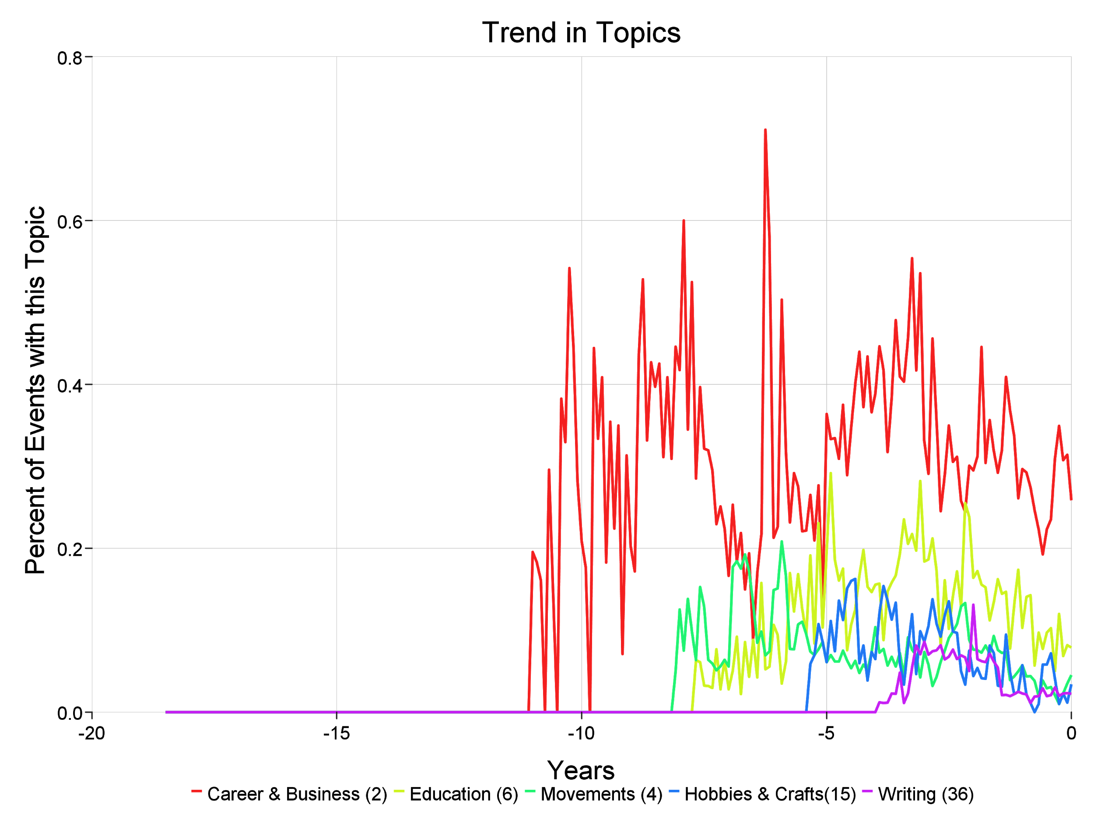
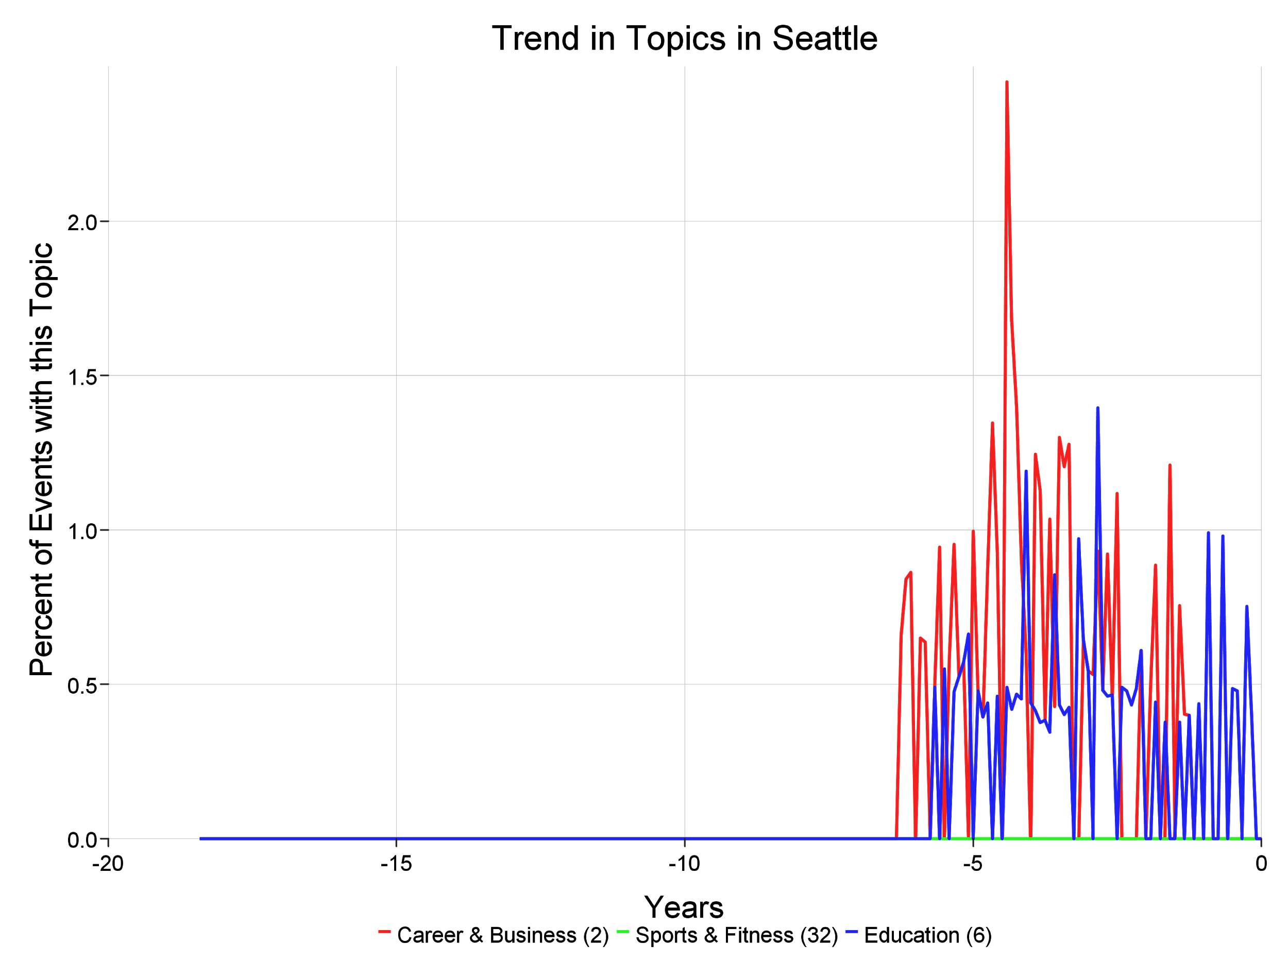
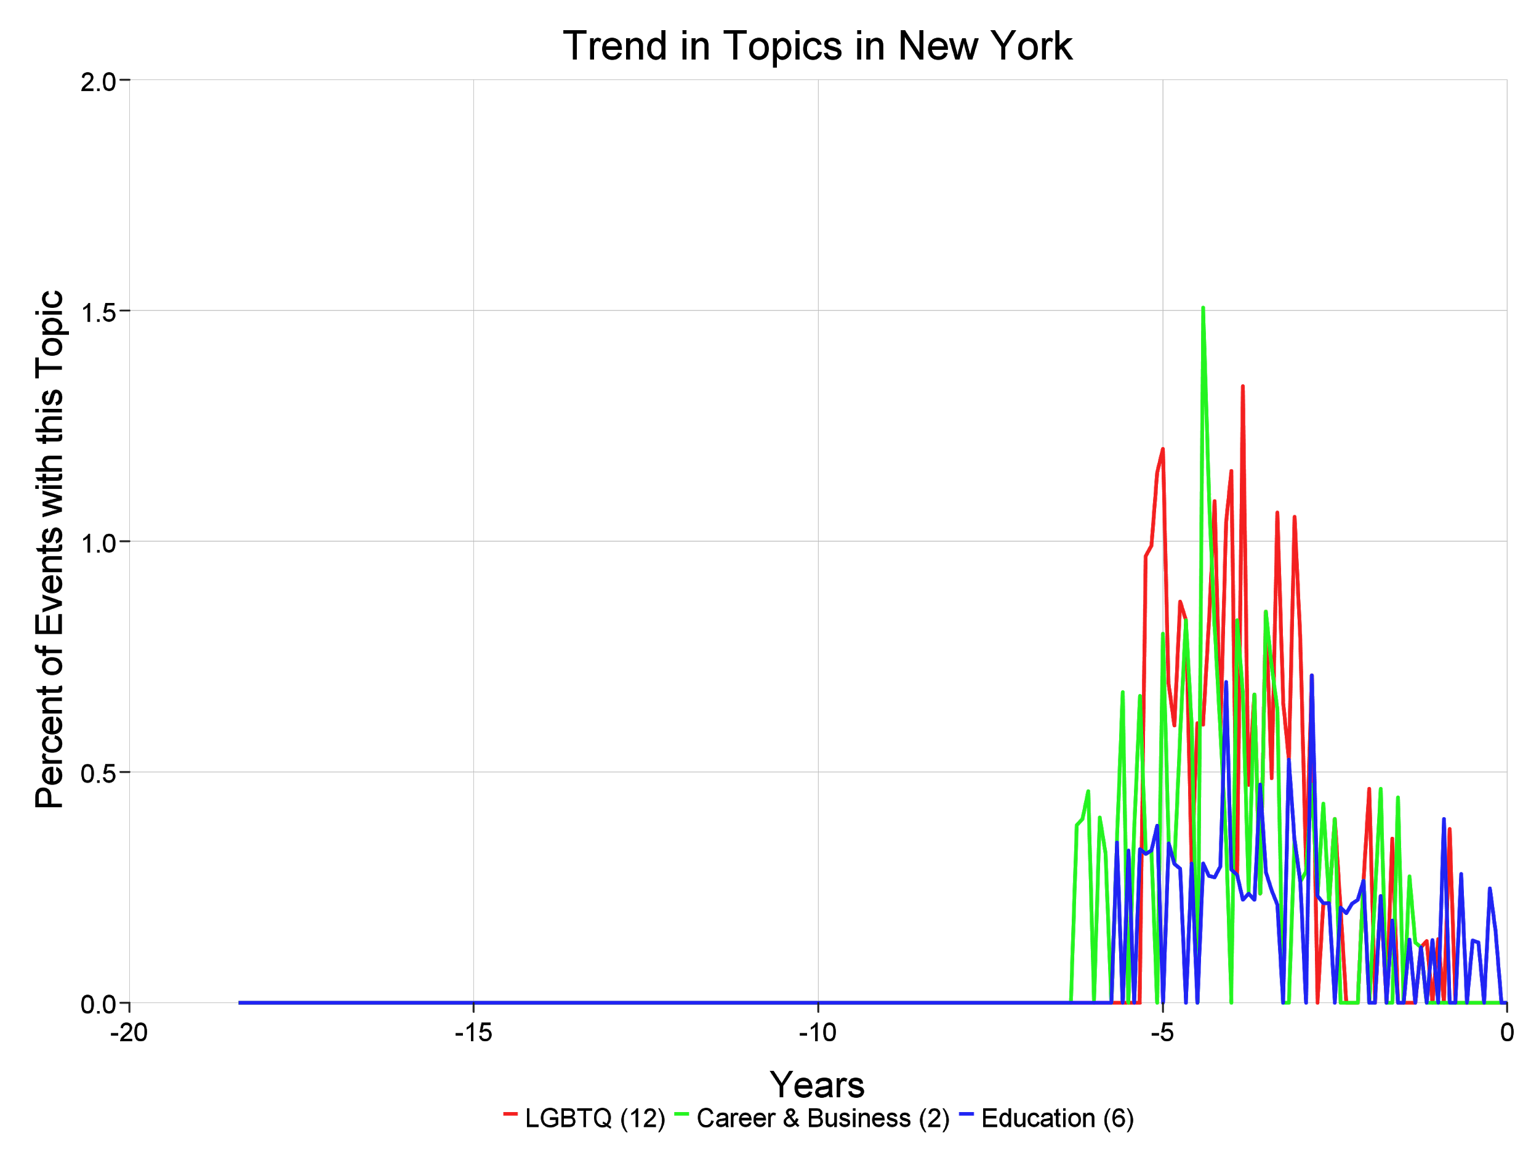
How do the trends in extra topics being used in a city compare to extra topics in the country as a whole?
Events start using other topics later that the country
Less topics occur but those that do are attached to more events
Within a city, there is a much higher likelihood of zero events being associated with an alternate category in a month
Notes:
Career and Business (2), Education(6), Movements(4), Hobbies and Crafts(15), Writing(36)
Career and Business(2), Sports and Fitness(32), Education(6)
LGBTQ(12), Career and Business(2), Education(6)
Seattle because I’m from Washington, New York because it had the highest number of alternate topic events

Slide 18
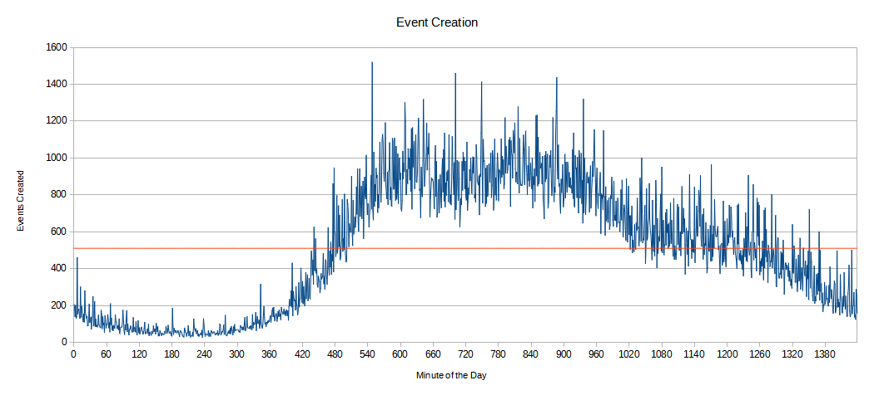
What is the most popular time when events are created?

Slide 19
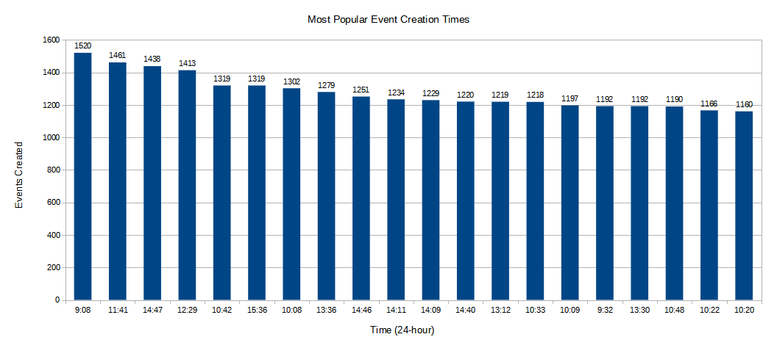
What is the most popular time when events are created?

Slide 20
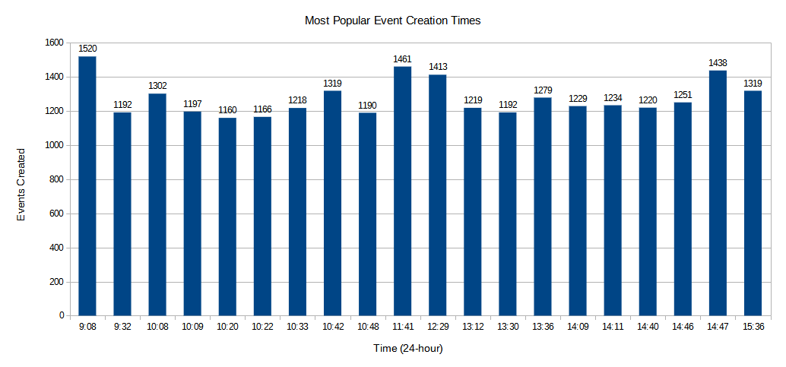
What is the most popular time when events are created?

Slide 21
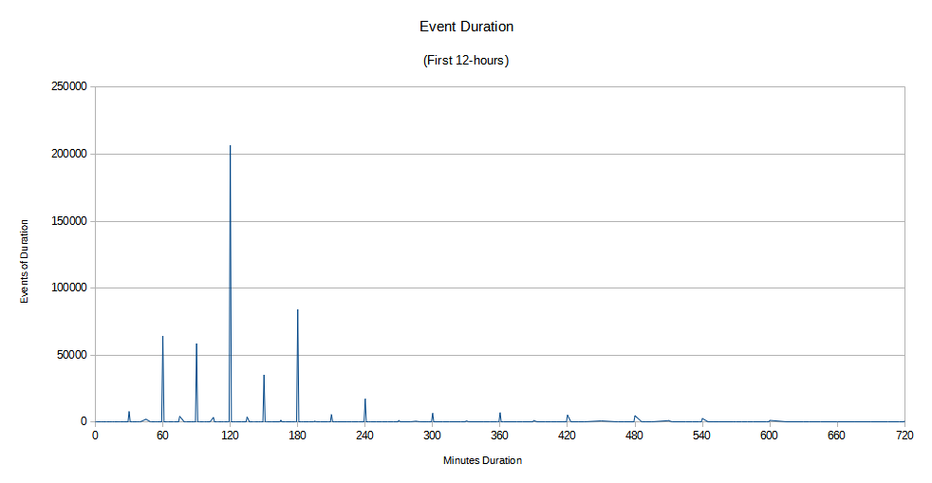
Are events with longer durations more popular vs shorter ones?

Slide 22
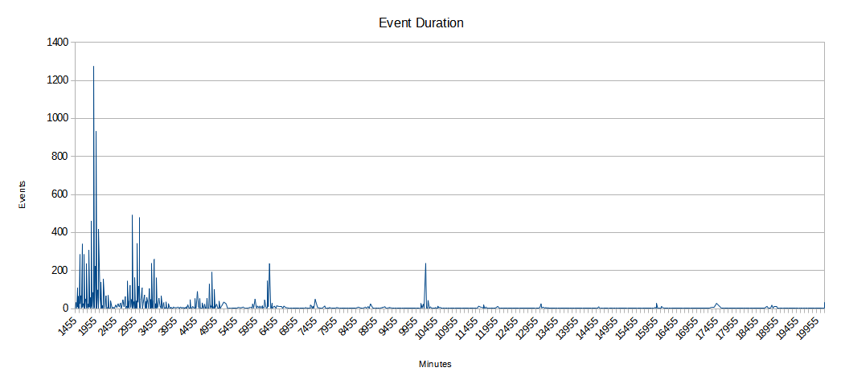
Are events with longer durations more popular vs shorter ones?

Slide 23
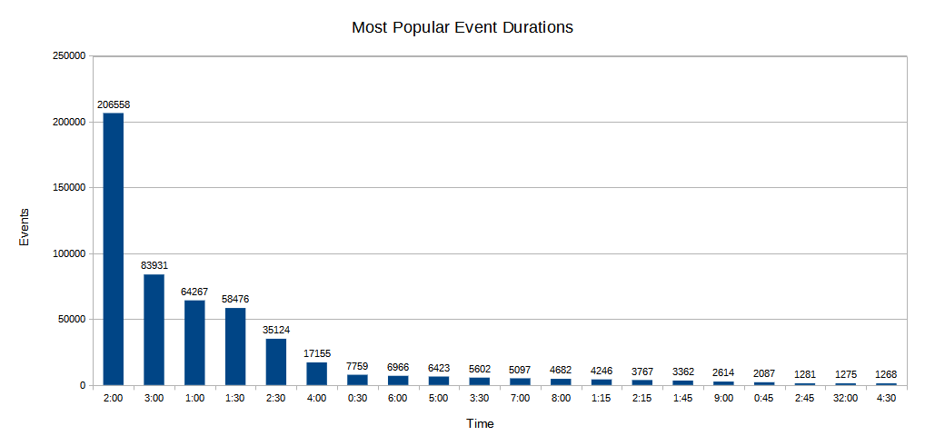
Are events with longer durations more popular vs shorter ones?

Slide 24
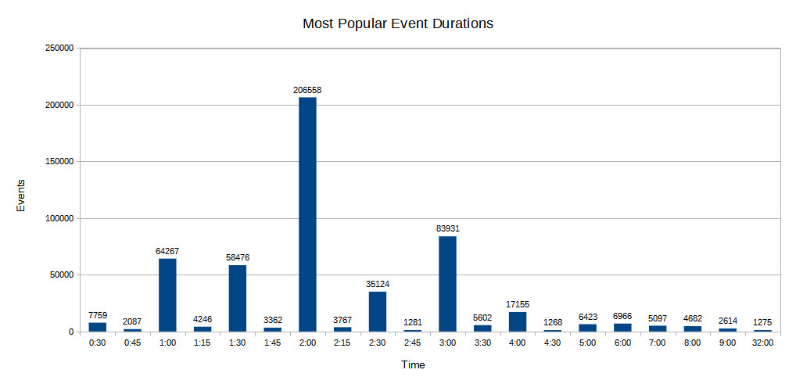
Are events with longer durations more popular vs shorter ones?
default

Slide 25
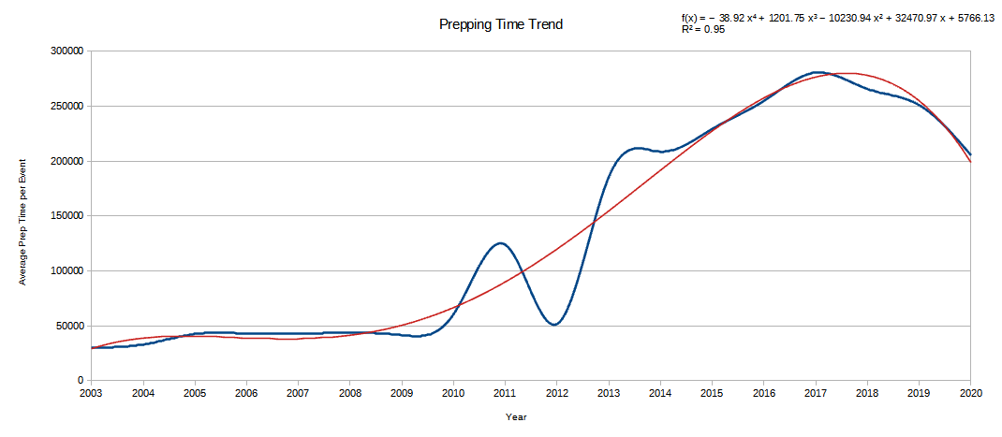
Has there been a change in planning times for events?

Slide 26
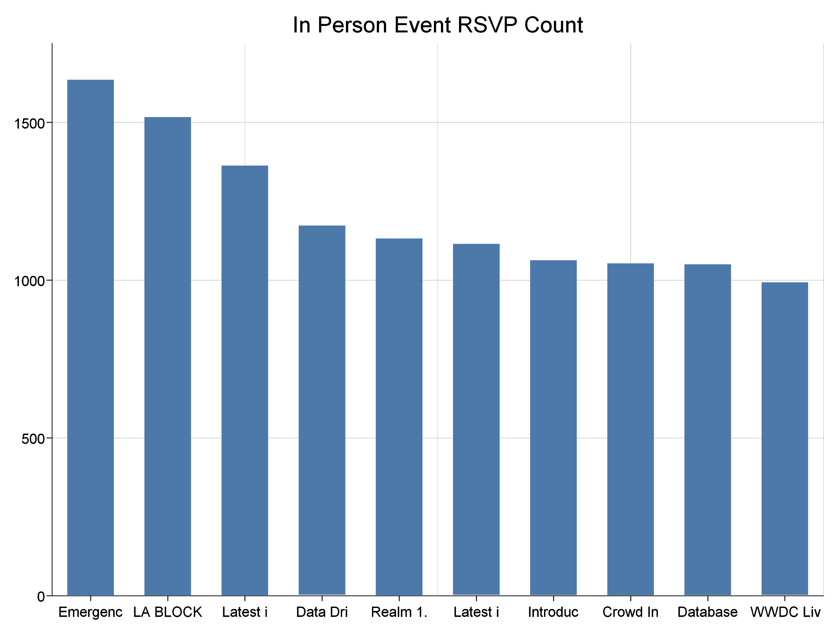
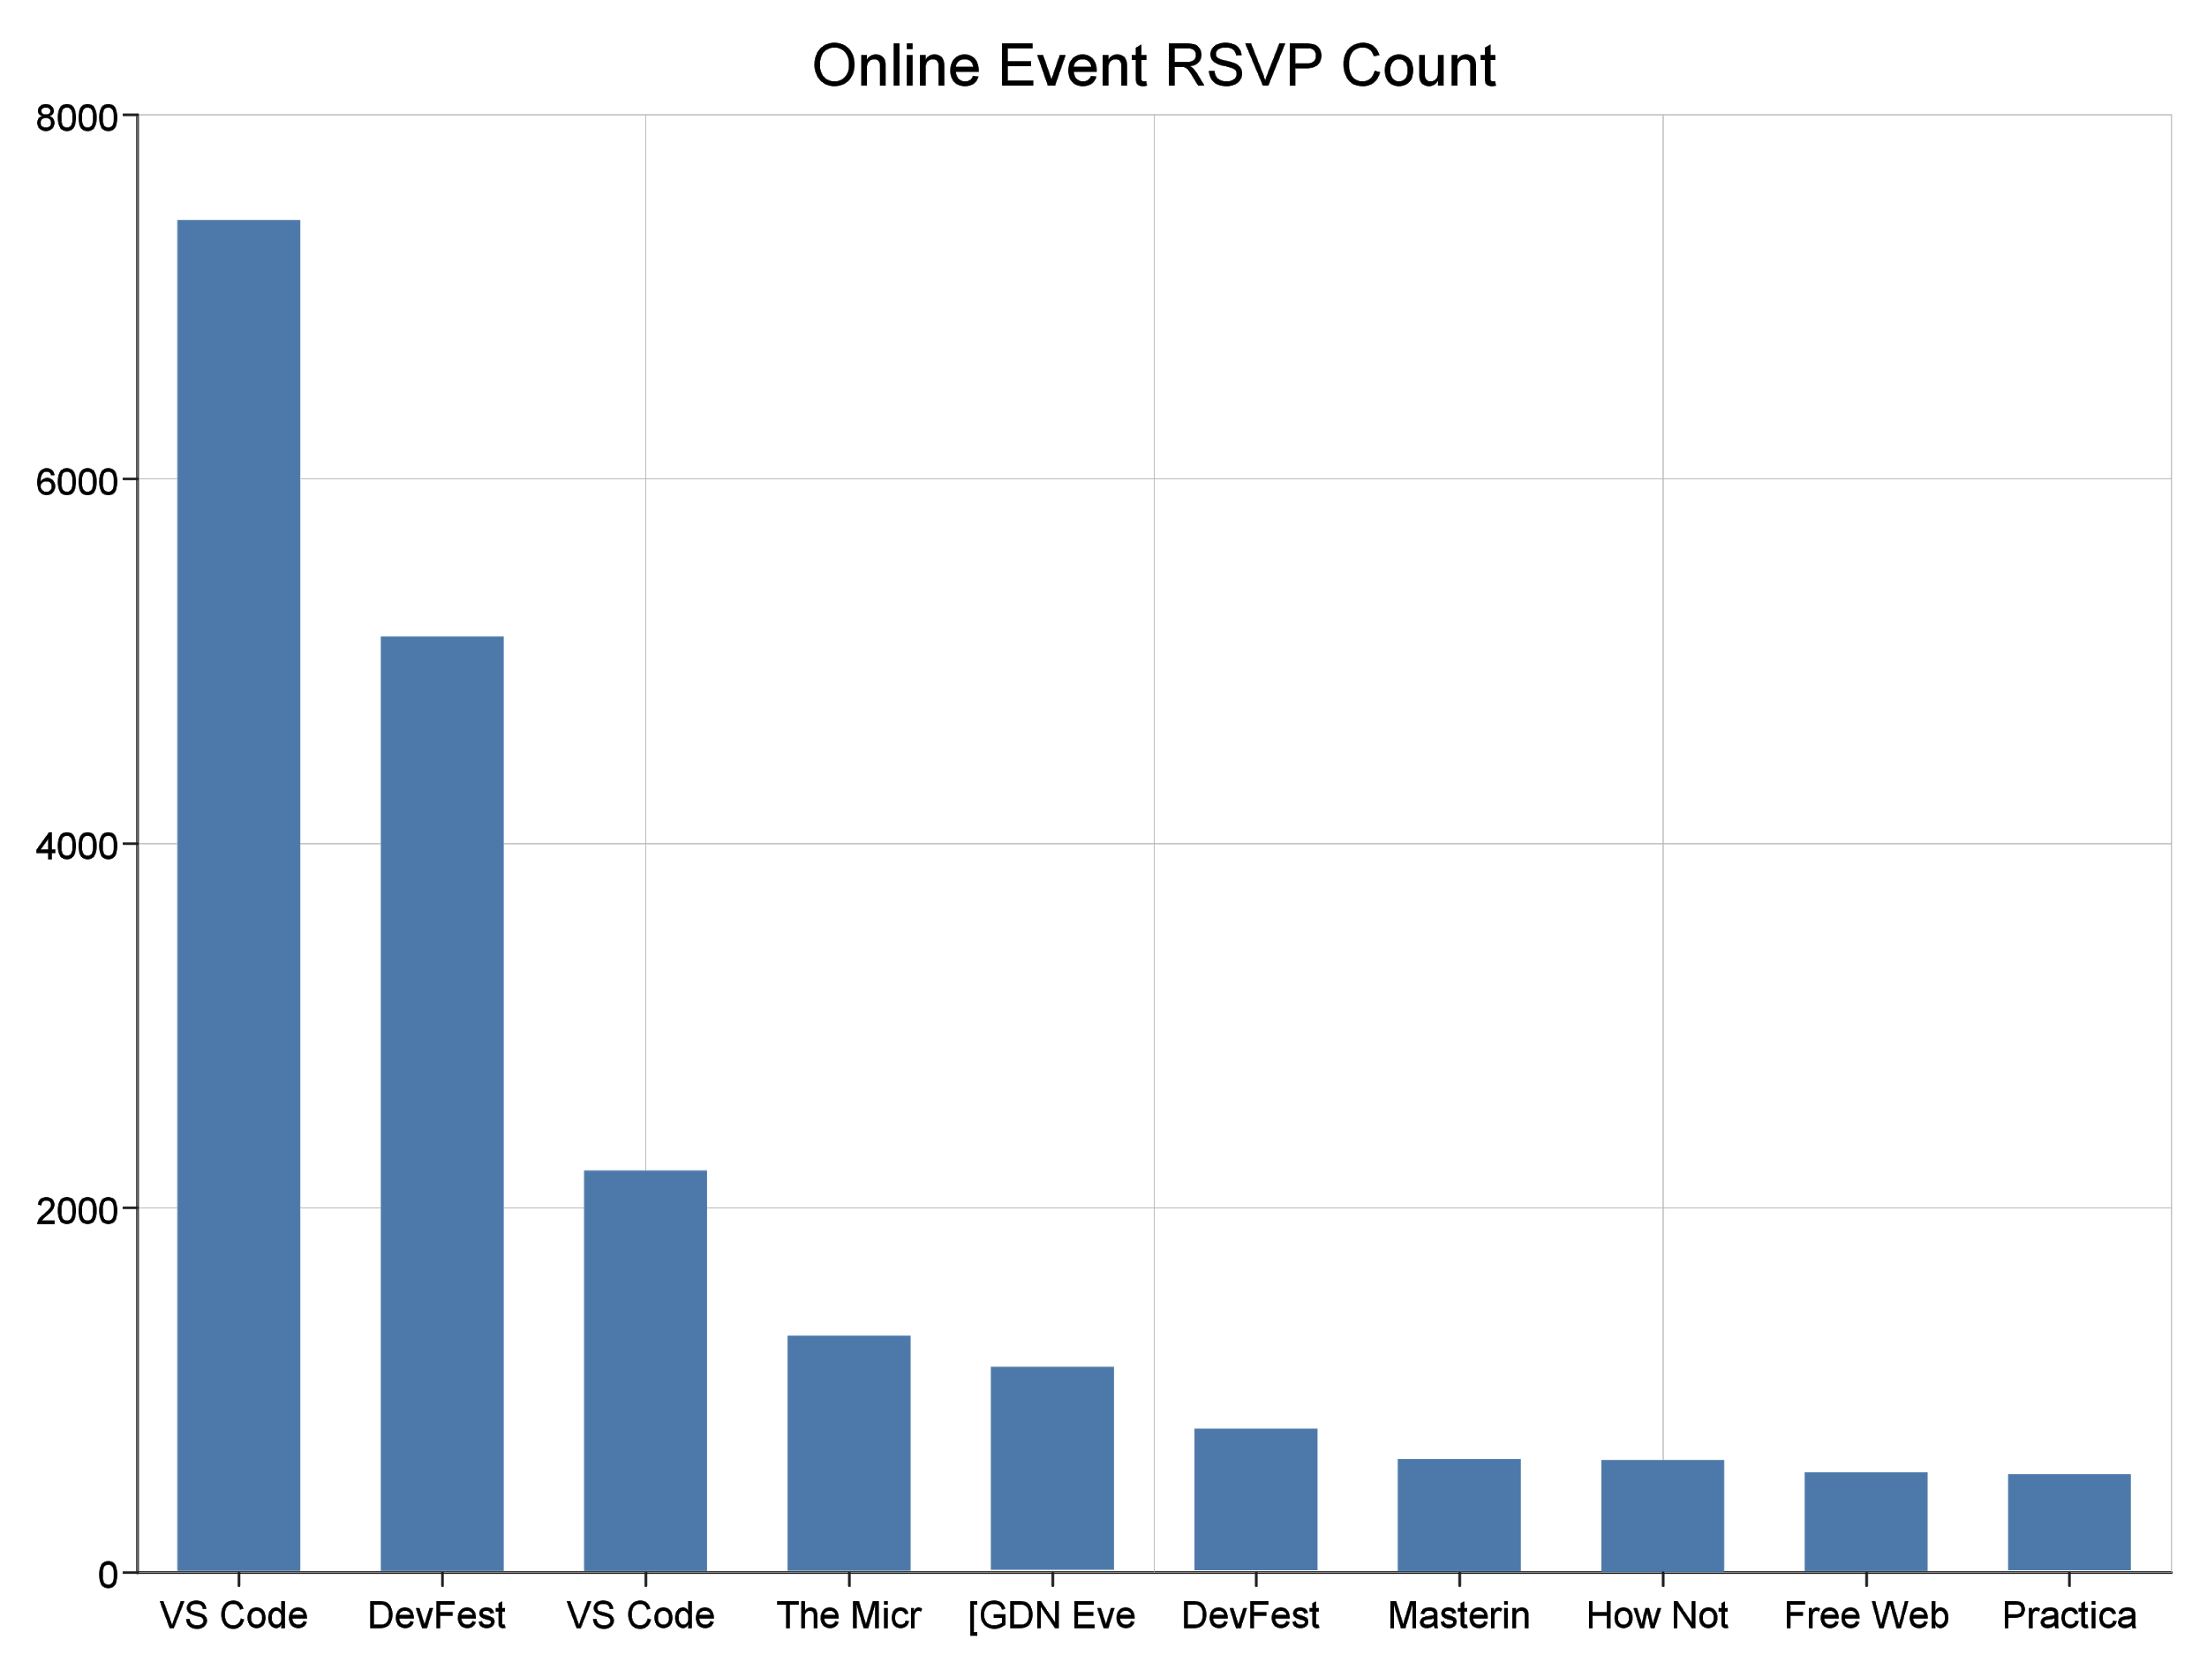
Which event has the most RSVPs?

Slide 27
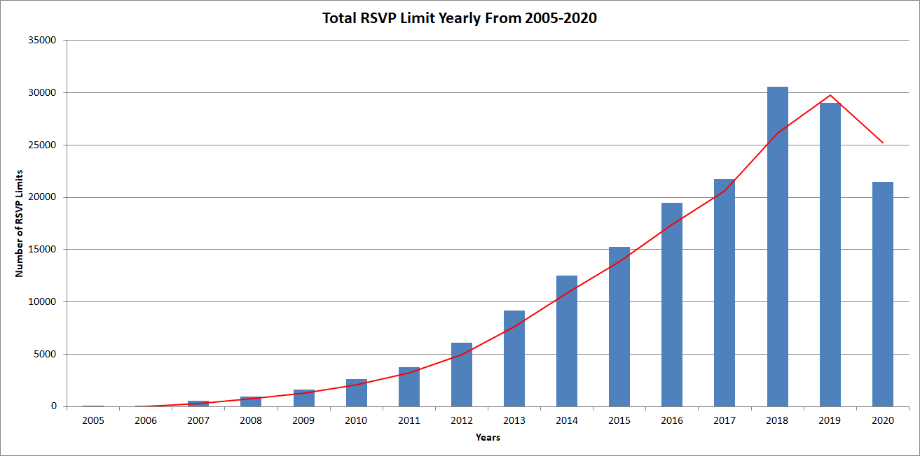
How has the capacity changed over months/years?

Slide 28
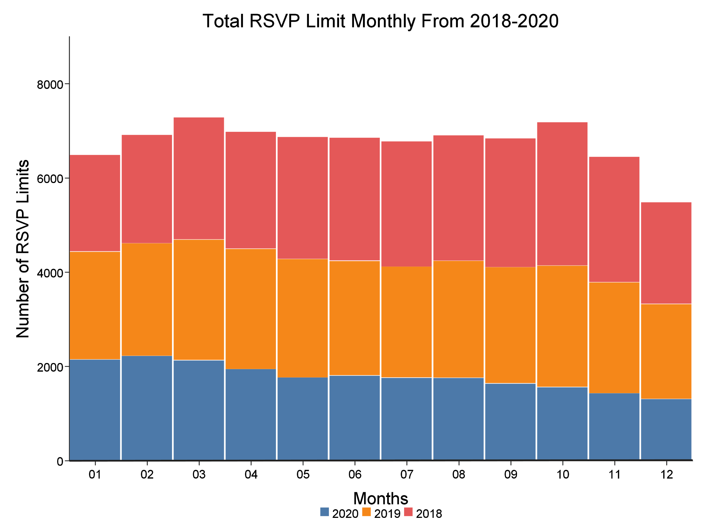

Slide 29
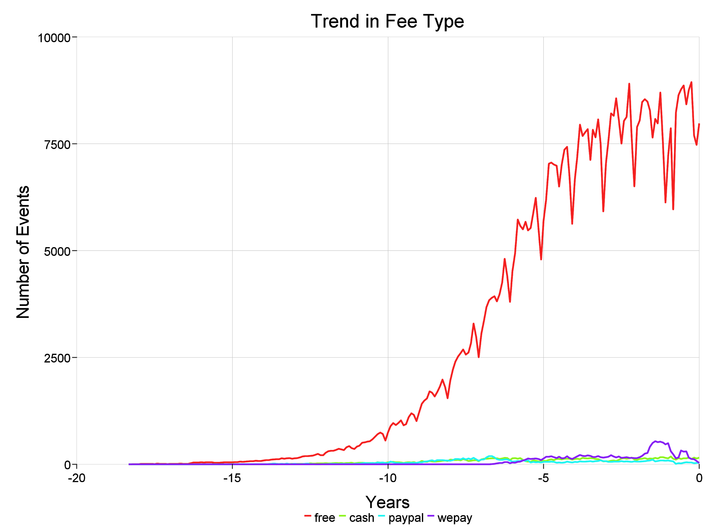
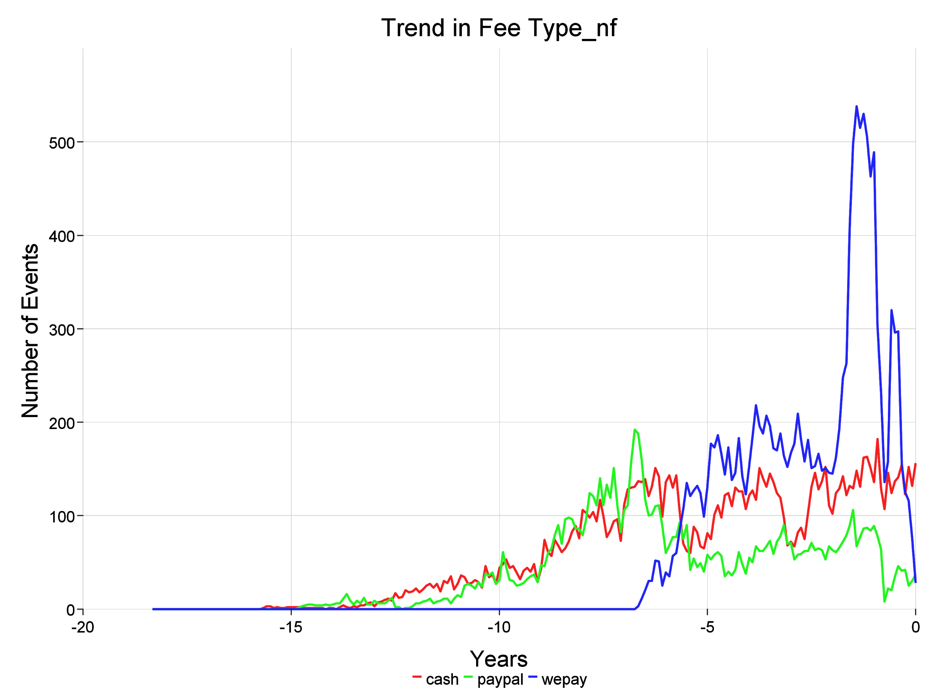
What is the preferred payment method for events?
There are three payment options
Cash
Paypal
Wepay
No payment option listed is taken to mean the event is free
Free events are most common
Cash and PayPal begin being used at the same time

Slide 30
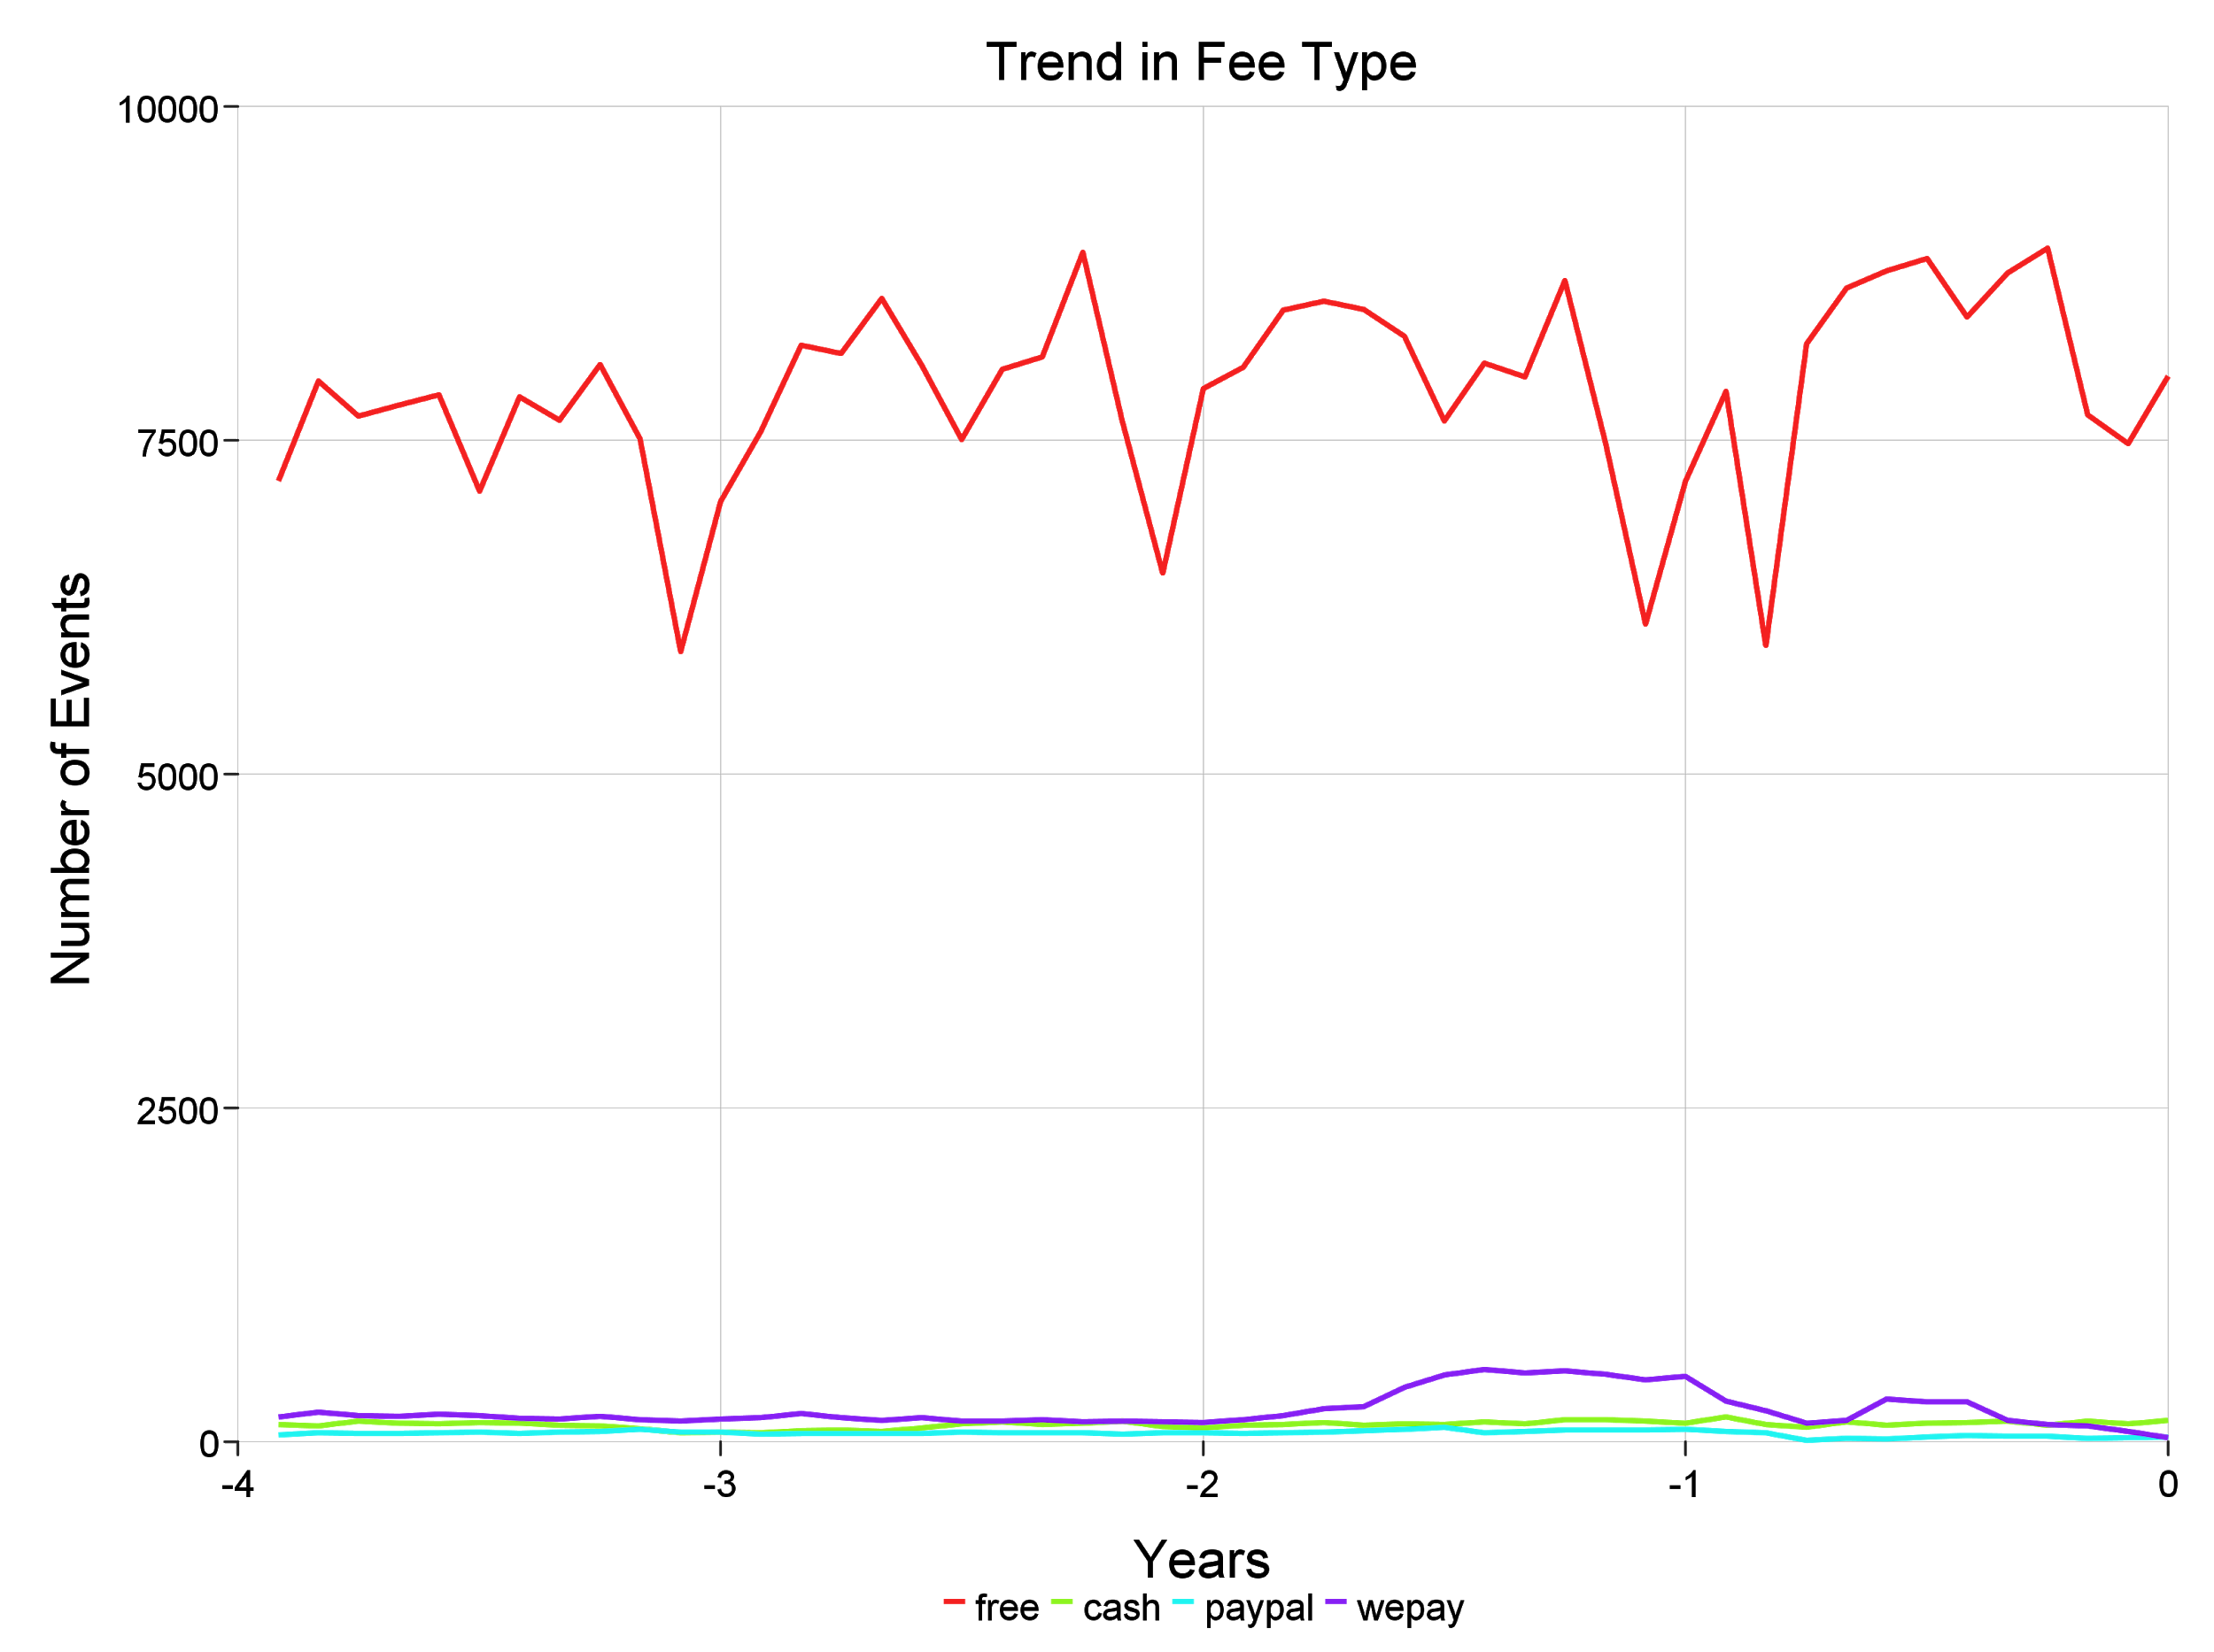
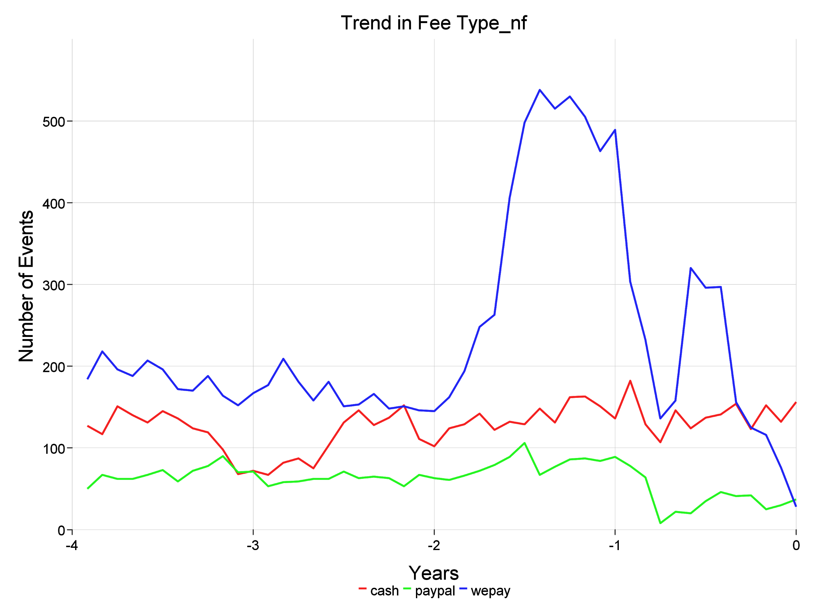
What is the preferred payment method for events?
WePay has a rapid fall from January to March of 2020 with only some recovery in the summer
PayPal does not get used as much WePay but has a similarly timed drop in use
Notes:
Similar shapes for free graph over the course of a year for 3 years before this year

Slide 31
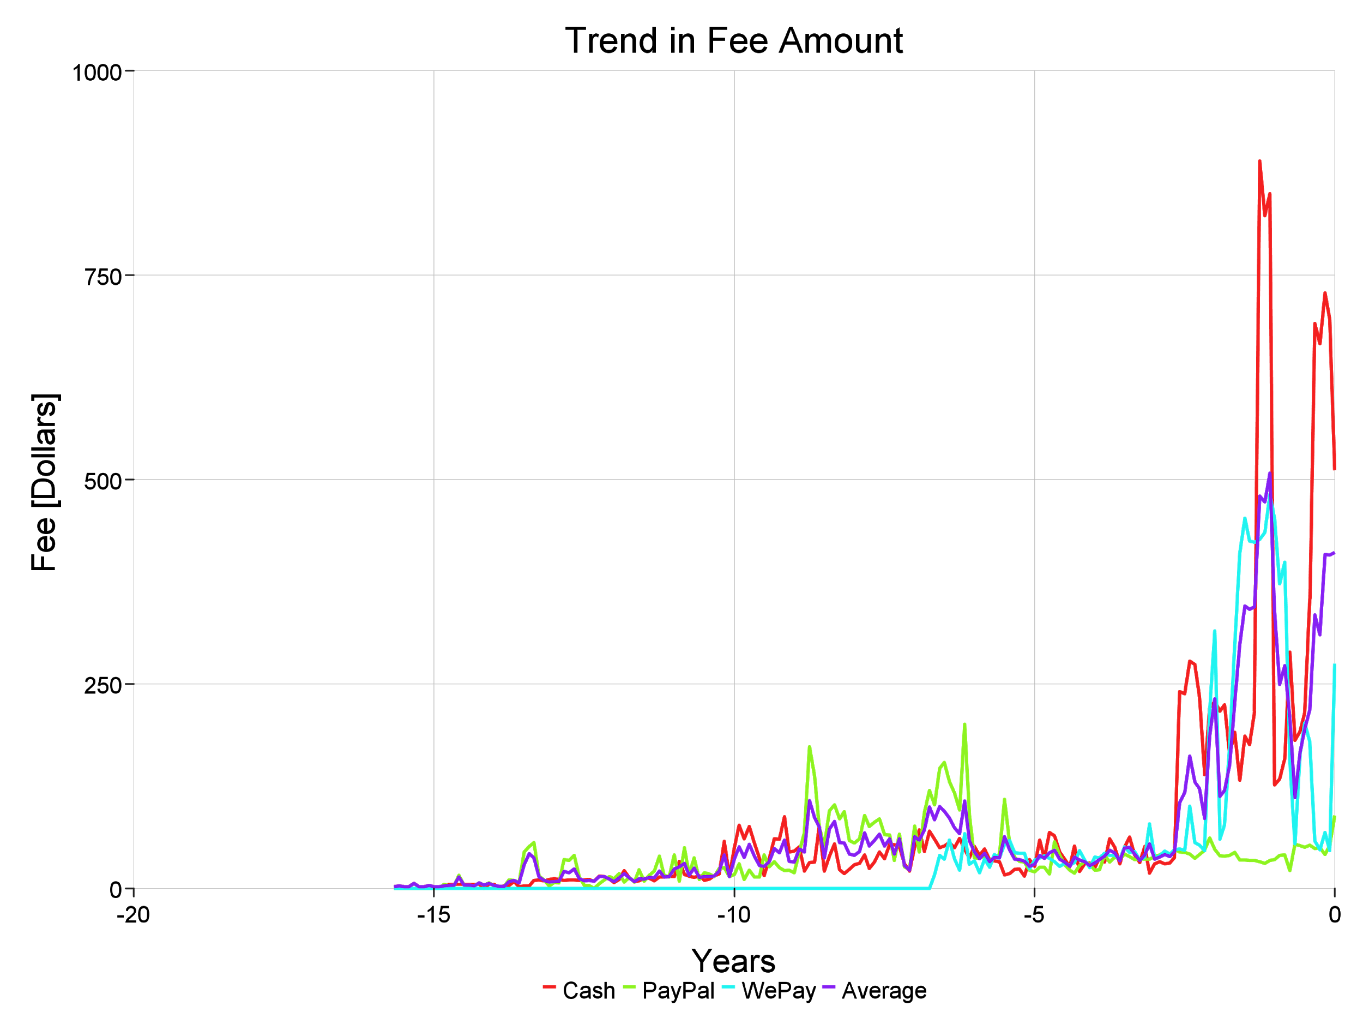
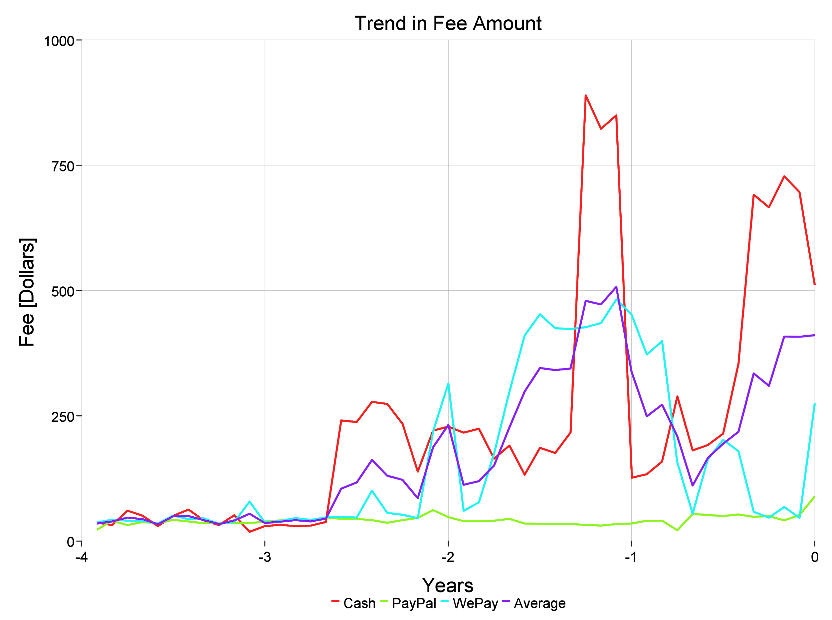
How has the average cost of events changed over time?
Cash fee is far more volatile in the than the number of events it is use cash
PayPal average fee falls shortly after WePay starts to be used
Past two years both have spikes near the end of the year in cash fee

Slide 32
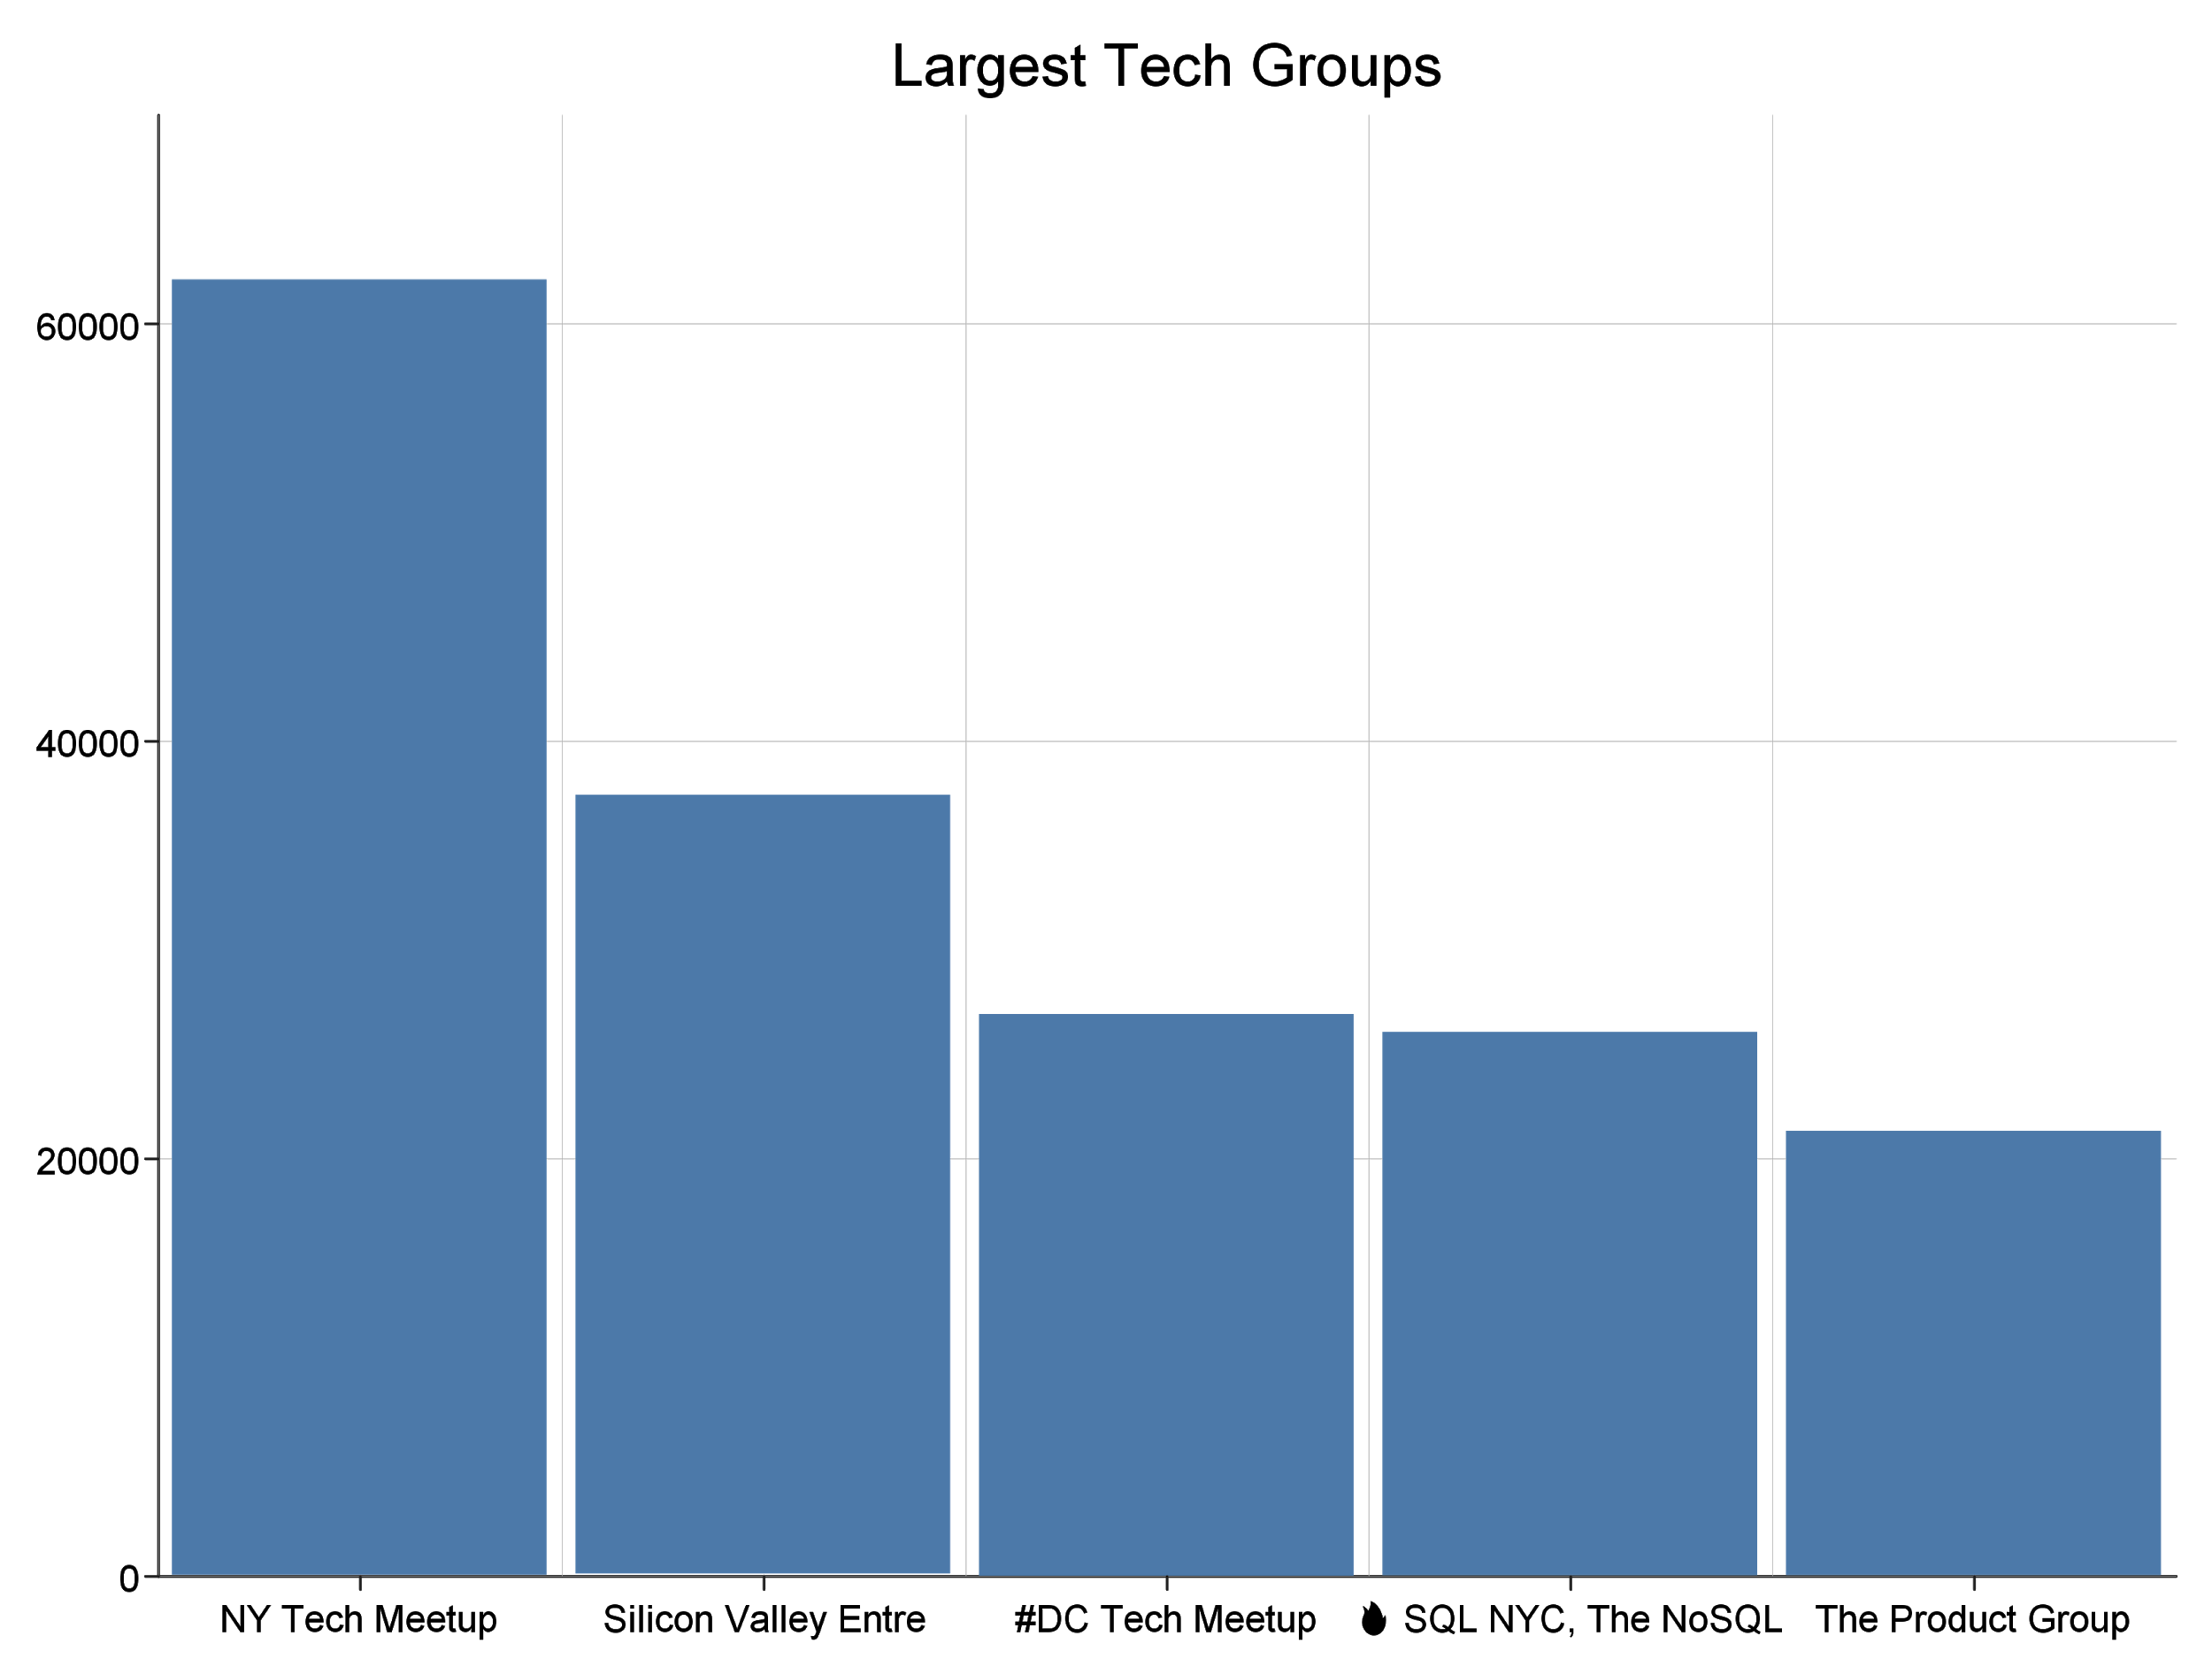
Largest Tech Groups by members
The “NY Tech Meetup group” has the most members.
Just over 62,000 members
Hosts Founder’s Spotlight events
“The Product Group” is the fifth largest group
Just over 21,000 members
Hosts Product Management centered events
Other notable large tech groups:
Silicon Valley Entrepreneurs & Startups
SQL NYC, The NoSQL & NewSQL Database Big Data Meetup

Slide 33
Thank you!
Questions?

